Slide 1
Co-creation
international
schools

Slide 2
Definition of co-creation
Creating a product with those who are meant to benefit from it.
In teacher education:
co-creating a programme with - student teachers
- international schools

Slide 3
The Peace of Utrecht The French negotiator to his Dutch hosts: “Nous traiterons sur vous, chez vous, sans vous.”

Slide 4
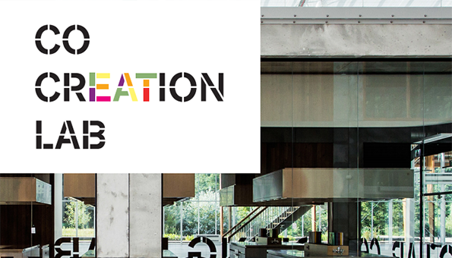
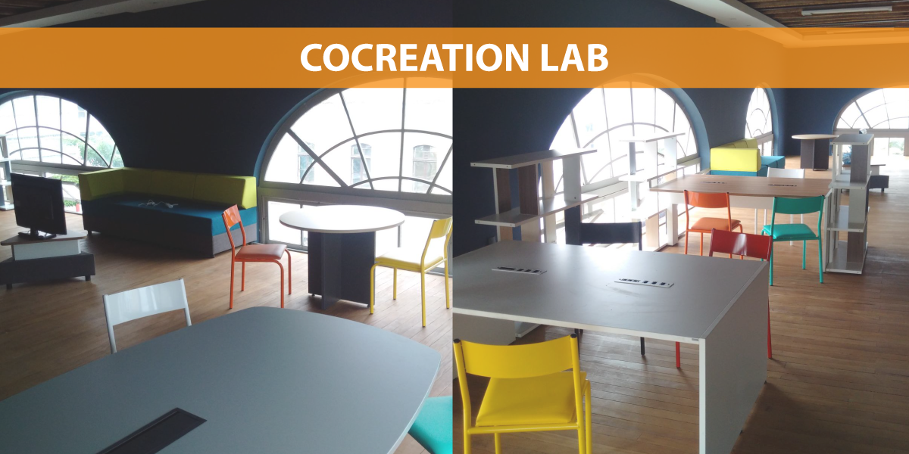
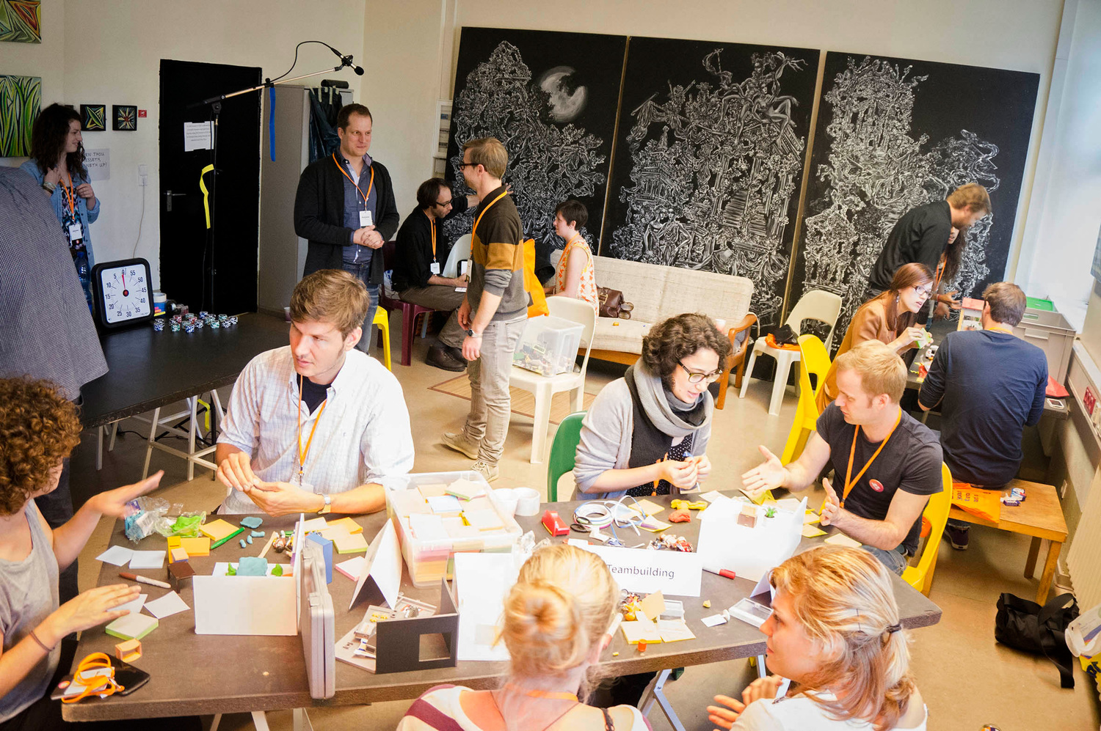
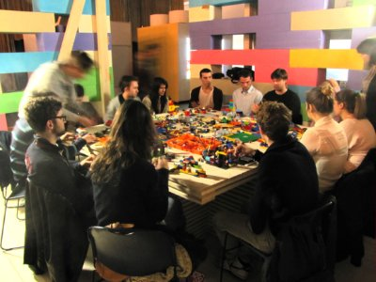
Co-creation to make new products useful

Slide 5
Co-creation ITELS International schools
Why co-create (parts of) a teacher education programme?
Benefits for teacher education
International school teachers know what really matters.
Co-created, authentic tasks motivate student teachers
Teacher educators and school teachers learn from each other.

Slide 6
Co-creation ITELS International schools
Benefits for international schools
International school teachers help educate future colleagues.
Helping to educate student teachers encourages teachers to reflect on their profession and gives them new ideas.
Teacher educators and school teachers learn from each other.
Co-created (preparatory) activities can make teaching practice more beneficial for student teacher and school.
Groups of student teachers come up with possible solutions for a dilemma or task set by the school

Slide 7
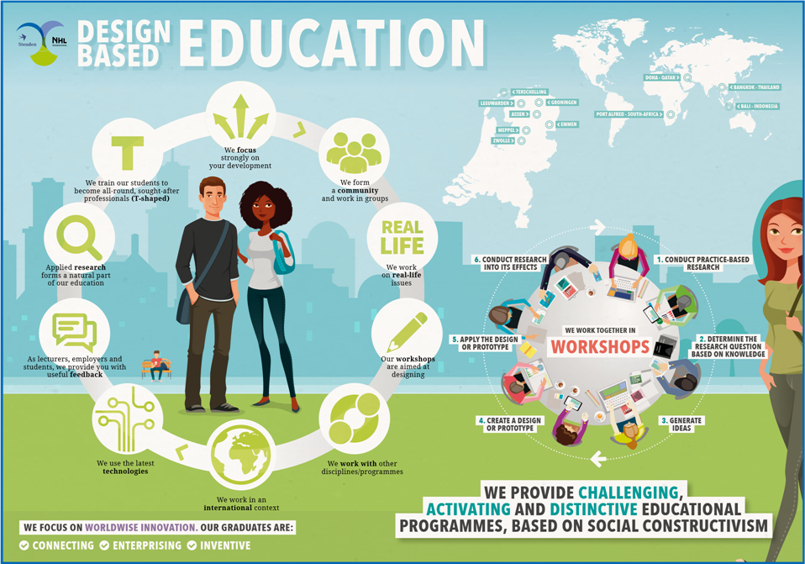

Slide 8
Scale of co-creation
5. Co-creation of full teacher education programme
4. Co-creation of substantial part of programme (e.g. minor, specialism)
3. A programme unit is organised as a community of student teachers, a teacher educator and school teachers who together design and develop a school project.
2. Teacher educators and school teachers together develop a programme unit; school teachers become ‘guest lecturers or coaches’.
1. School teachers and leaders give feedback on programme learning outcomes, structure and didactic approach (advisory committee, feedback sessions)

Slide 9
1. Advice by professional field
Advisory committee: school leaders, mentor-teachers, international organisations in education.
Feedback on curriculum by school mentor-teachers (questionnaire or skype interview).
Network of international school teachers comments on new developments in teacher education and suggests curriculum improvements.

Slide 10
2. Co-creating a curriculum unit
Unit duration: e.g. students spend half a week during two months
Unit content: e.g. subject field or Educational Studies or Research
Teacher educators design and/or develop the unit with school teachers.
The unit may be carried out with the help of school teachers (e.g. guest lecturer, recorded TED-talk, online access to a teacher’s classroom, event in online schools network).

Slide 11
3. Unit organised as a community that designs and develops a school project or learning cycle
School(s) give a general indication of what they would like to have designed
Teacher educator checks feasibility and suitability
Student teachers are briefed about the task by the school(s).
Student teachers analyse the task with the help of school teachers (school students) and a teacher educator.
Student teachers generate ideas and design a prototype.
Prototype discussed with school and tried out, if possible
Final design ready for use; evaluation/debriefing after use.

Slide 12
4. Co-creation of a specialisation
Duration of specialisation: one full semester
(A group of) schools intend to deepen and share special expertise.
Teacher educators would like to add this expertise to their programme as a specialisation
Experts from schools and teacher education develop the specialisation together.
Student teachers acquire the expertise in a learning environment which includes practice (and research) at the schools

Slide 13
Co-creation of full teacher education programme
Will be attempted once smaller co-creation projects have proved succesfull.

Slide 14
Some characteristics
Four-year Bachelor programme for Teacher Education Secondary
(age group 11 – 16)
International student population
Concurrent model: professional preparation and subject knowledge in each year (integration and transfer between domains)
International and intercultural context permeates all units
Teaching practice in international schools in every year
Preparation for teaching in MYP, IMYC, IGCSE and local curriculum
English programme; student teachers achieve level C2
Students study at a partner university for one semester

Slide 15
Curriculum
 | Year 1 | Year 2 | Year 3 | Year 4
Semester 1 | Educational Studies (10 EC) Teaching Practice (5 EC) Democratic Citizenship (10 EC) English (5 EC) Main subject field (30 EC) | Educational Studies (10 EC) Teaching Practice (10 EC) Research (10EC) | Educational Studies (10EC) Teaching Practice (10EC) Research (10EC) | Main subject field (30EC)
Semester 2 |  | Main subject field (30 EC) | Second subject at partner university (30 EC) | Educational Studies (5EC) Teaching Practice (10EC) Bachelor Thesis (15EC)

Slide 16
Two minutes for some first ideas
How could you / your school contribute to international teacher education?
How could your contribution benefit you or your school?

Slide 17
Develop an example of co-creation
Think of an example of co-creation between international school(s) and teacher education.
Explain your example to the others in a group of four.
Select one example and develop it together.
Write down the group example (and note what questions it raises).

Slide 18
Alex van der Stouwe
Project leader International Teacher Education (secondary)
NHL Stenden University, the Netherlands
stouwe@nhl.nl
+31 628305373

Slide 19
Extra information about My Schools Network
My Schools Network
https://www.youtube.com/user/MySchoolsNetwork (You Tube)
http://www.myschoolsnetwork.com/info (site)

