Slide 1
THE ART OF INTERNATIONAL SCHOOL LEADERSHIP & GOVERNANCE
Russell Speirs, CEO and Founder, RSAcademics Ltd
Notes:
Is there anyone here who contributed to our research – who completed our questionnaire?
Has anyone here actually had a chance to read our report?
We have a few copies here, and it is also available for download as a PDF on our website RSAcademics.com

Slide 2
Focus of our research
Qualitative – based on current international school leaders’ views
Key challenges for leaders
Qualities needed for success
Today’s session:
Presentation – focused on top challenges
Discussions – opportunity to share insights and experience on successfully dealing with these
Notes:
Our research is based on the views of current international school leaders, and we were interested in the view on two particular aspects:
What are the particular challenges of leading an international school – over and above those of a domestic school
What do international school leaders need to be particularly good at.
So we were trying to focus on the particular and additional challenges of international schools rather than taking about leadership more generally.
Our session today . We are going to give a short presentation highlighting some of the key challenges that people talked about most. Then we thought you may value an opportunity to discuss your approach and share insights in how you successfully deal with these.
We have identified the 4 most mentioned challenges and then you could choose which of these might be of most interest to you. We have some questions to help facilitate your discussion.
We thought that leaders you may value the opportunity to share knowledge and experience in this way.

Slide 3
Research sample
Asia | Questionnaires
Heads | 52
Senior Leaders | 20
Board Members | 9
Gulf Region
Heads | 24
Senior Leaders | 2
Board Members | 1
Total | 108
Plus:
Follow-up phone interviews with selected participants
76 schools
Notes:
We had over 100 participants. Mainly heads at 76 schools, and all based at schools in Asia and gulf regions (which we chose because they are particular areas of growth.
Perhaps one point to emphasise is that these are very different institutions with their own unique histories, contexts etc. We are not trying to pretend that there is one set of challenges for all schools, and indeed in our report we get into the importance of fit of any leader to the type of school.
However we were struck by a lot of commonality and in our report we focus on this but using a lot of quotes to illustrate the context.

Slide 4
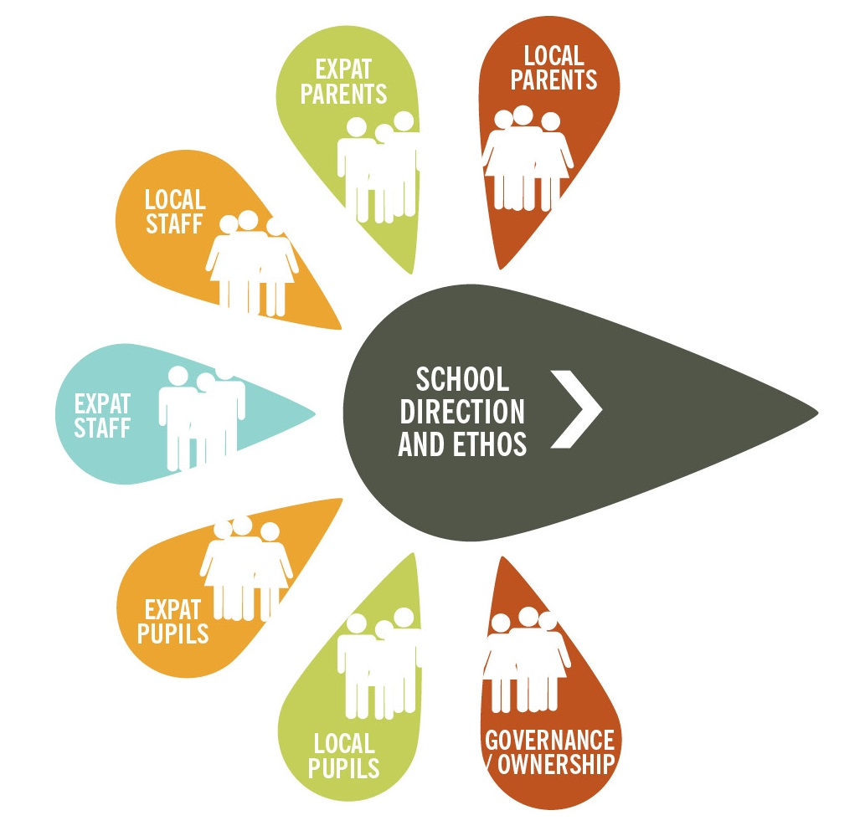
The key challenges – complexity & Diversity
The challenge of developing and implementing a unified vision in a diverse context
Notes:
The themes of complexity and diversity ran through a lot of the challenges.
This could be diversity of parents and their expectations, or managing a diverse staff.
If leadership is about bringing people together to make progress towards a common goal, then this is particularly challenging given the diverse and changing school community.

Slide 5
Challenges of international school headship
Notes:
The challenges – we collected these together from all our replies and cateogorised them under these 7 main headings.
For today, I thought I would just highlight the 4 most often mentioned ones
School is short for school community – e.g. the amount of change in personnel

Slide 6
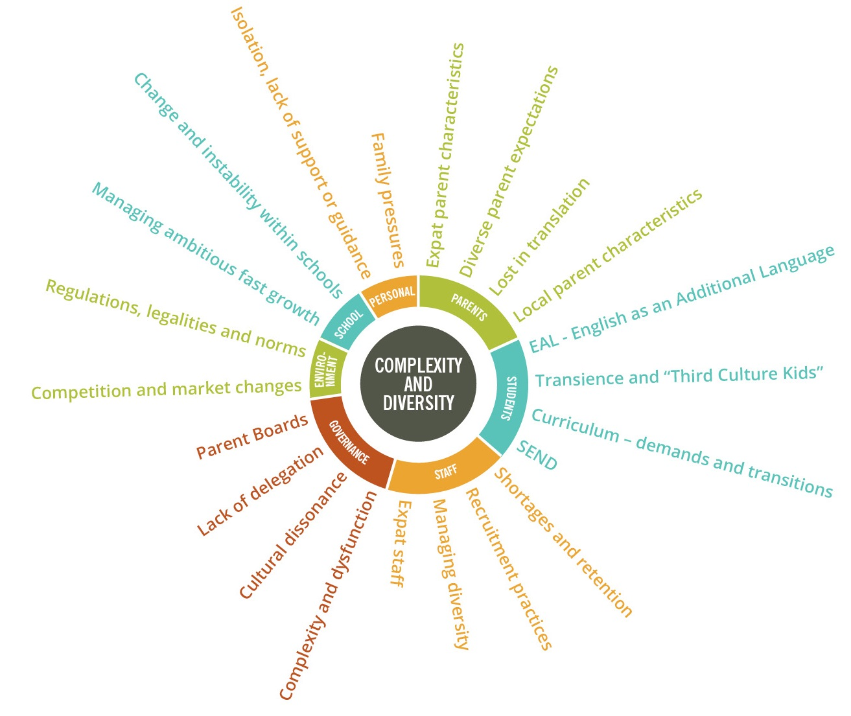
Some CHALLENGES OF international school headship
Notes:
This is an attempt to summarise all the key challenges that emerged from our research, A copy of which you have as a hand-out.
I’ll highlight a few of these……

Slide 7
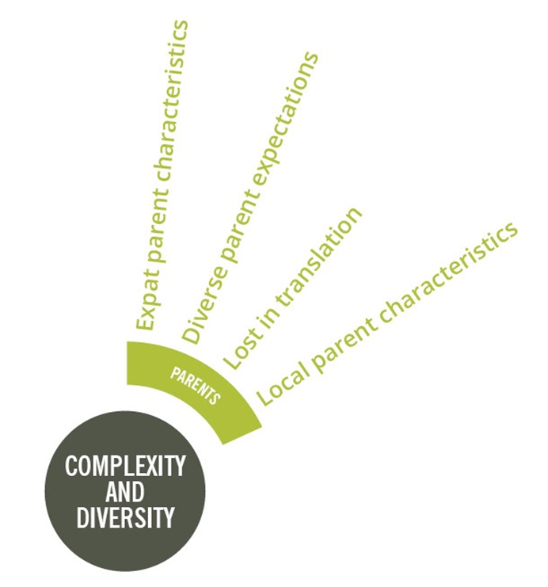
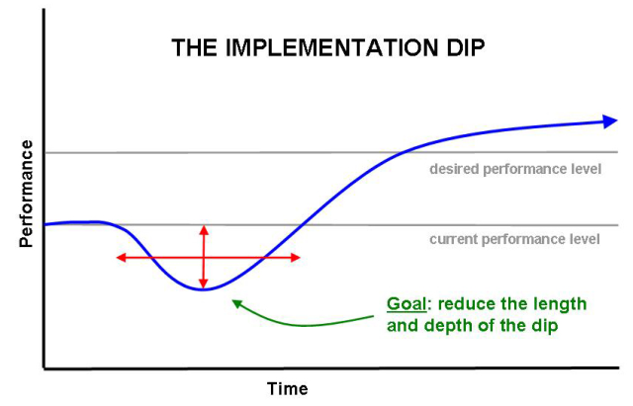
LEADERSHIP Challenges - parents
“the on-site coffee shop created the perfect storm …”
“the polarity between expat and local parents’ expectations can be extreme”
“it can be very difficult to get to the heart of an issue”
“sometimes expectations are crazy, literally”
Notes:
Parents:
Expat parents often have an intense and close relationship with the school. They may even live in the vicinity. Trailing spouse main focus of their social life may be through the school.
There may be guilt and anxiety. Guilt from uprooting the child and the anxiety of living abroad.
One head told of his regret of having a coffee shop on site, where all the parents meet. Any problems or issues escalate and become exaggerated.
First time buyers – treat it like any other transaction – may not choose to establish the partnership relationship.
Diverse parent expectations – the Head may have to spend much more time going back to basics “what is a good education”
The problems of communicating – both language and culture. This is a book by itself. Cultural iceberg. Opportunities for conflict, misunderstandings.
;
Local parents. Of course varies, but a common theme is unrealistic expectations. They want their children to learn English and go to international university, may not really buy into / understand other aspects of the school.
Also consider the “implementation dip” – the temporary drop in standards when you try to change something. There may be much less tolerance for this with international school parents who are watching so closely. It may encourage risk aversion which may be the opposite of what you are trying to teach children!

Slide 8
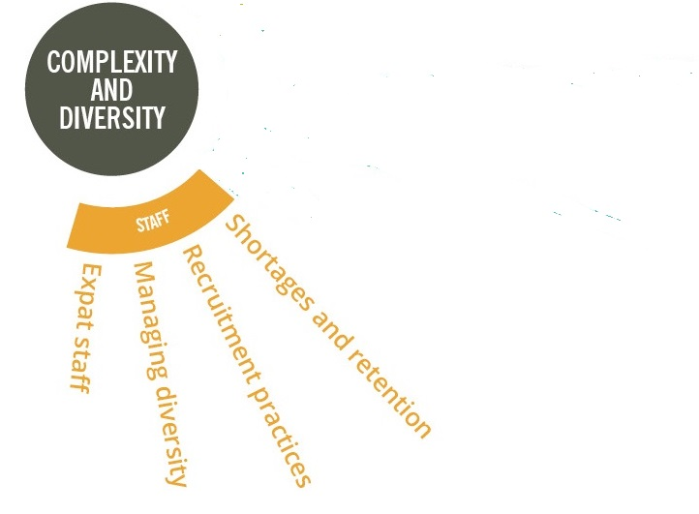
LEADERSHIP Challenges - STAFF
“staffing is the biggest challenge facing international schools today”
“recruitment is the most important thing I do all year”
“the main challenge is to bring a common sense of purpose across such a diverse group of staff”
“my pastoral challenges are staff issues, not student matters”
Notes:
Much more time required.
The “teaching tribe” – 2 to 3 years in each country. One teacher moved 17 times in 30 year career.
Many Heads describe recruitment as the most important part of their job.
Growth = shortages, maybe especially in IB. Typical 2 year contracts = churn.
Huge focus on recruitment. Difficulties associated with remote recruitment. Recruitment fairs expensive and limited contact time. No opportunity to observe lesson. Skype is often best way. Maybe video of lesson. References essential – but a lot of bad recruitment practice exists.
Diversity of nationalities and cultures. Imagine how any activity is more complex – e.g. appraisals, change management, communication.
Example of staff meeting dominated by western expats. Switched to online comments which people were more comfortable giving.
All the issues with expats! Mobilisation, policies, visas, family, close knit staff (blessing and curse),

Slide 9
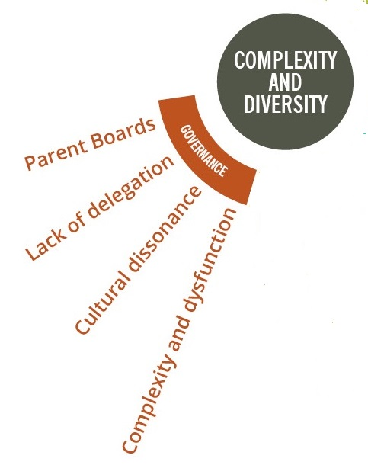
LEADERSHIP Challenges - GOVERNANCE
“I have 5 different groups that I report to and communication between those groups relies on me”
“85% of my teachers are international but 100% of board are local”
“I am the 6th Head in 11 years!”
“audit is valued over innovation”
“between my appointment and start date, 75% of our parent Board had changed!”
Notes:
Governance – this was the #1 challenge for the many of the Heads surveyed. People talking about a crisis in international schools etc.
One important point – it’s not just a question of “For Profit” vs “Charity / Not for Profit” – it’s more about the usual things: clarity of purpose and processes, Board make-up and conduct of the individuals concerned.
There are concerns about multi-level boards, remote boards, owners who are non-educationalists with unrealistic expectations for profit and pace of change. We heard of some schools with incredibly high turnover of Heads – 6 in 11 years!
Adding to the challenge of getting alignment – cultural dissonance. You may have an expat Head and faculty, and parent body, but a local national board. Many Heads talk about this as a real learning curve when moving locations.
What is Executive vs Non-executive role. Common issue in many schools domestic and international – but seemed to be mentioned even more in our research.
Parent Boards – big issues with turnover of members. One Head told us between being appointed and starting the job only 25% of the board remained!

Slide 10
LEADERSHIP Challenges – PERSONAL & FAMILY
“it can be very lonely - it’s difficult to find real friends when everyone you know is inside the school community.”
“I wish I had known where to reach out for support”
“several heads leave due to personal and family reasons”
“the Head is looked after, but the family has a much harder job to cope”
“its crucially important to look after yourself physically, emotionally and spiritually”.
Notes:
Personal and family – this could ultimately be the deal-breaker.
In many international schools there is very limited support:
Professional – e.g. professional codes, external frameworks, e.g. around safeguarding or other compliance matters
Personal – often the only people you know are in the school community so you can’t have any real friends!
Family – pressures on children, spouse, relocations, doing all the basics (e.g. visas, importing goods, getting a bank account, insurance, driving, car etc.
The Head is busy and timetabled – what does the spouse do? Could be a recipe for a broken marriage? Or living apart during term time can take its toll.

Slide 11
Some CHALLENGES OF international school headship

Slide 12
DISCUSSION

Slide 13
Discussions which challenges are of most interest to you?
Governance
When you were appointed to your current role, is there anything you wish you had asked or been told about in relation to working with the Board?
What have you learnt about managing upwards through your own experience – success and failures?
Parents
What works best when communicating with diverse groups, e.g. local parents and expat parents, different nationalities or occupation groups?
How do you harness the energy and interest of expat parents?
Staff
Managing issues specific to expat staffing – what are your top tips?
How do you successfully induct new staff into your organisation?
Personal or family
Professional – what personal support and advice helps you in your role?
Personal – how do you build your resilience to cope with pressures?

Slide 14
THE ART OF INTERNATIONAL SCHOOL LEADERSHIP & GOVERNANCE
Russell Speirs, CEO and Founder, RSAcademics Ltd
Notes:
Is there anyone here who contributed to our research – who completed our questionnaire?
Has anyone here actually had a chance to read our report?
We have a few copies here, and it is also available for download as a PDF on our website RSAcademics.com

