Slide 1
Hiring ONLY Native Speakers:
The future of IB World Schools?
Peter M. Sagun
Alliance for International Education Conference
Amsterdam, Netherlands
Saturday, 7th October 2017

Slide 2
Brief History

Slide 3
IB Mission Statement

Slide 4
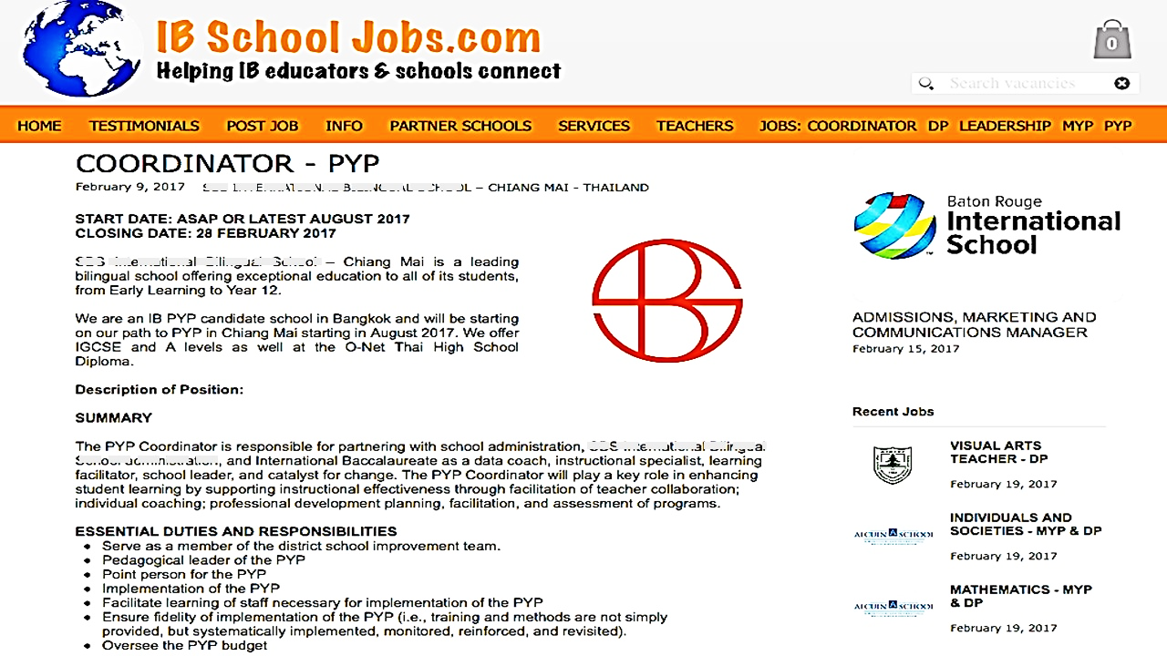
Hiring ONLY Native Speakers

Slide 5
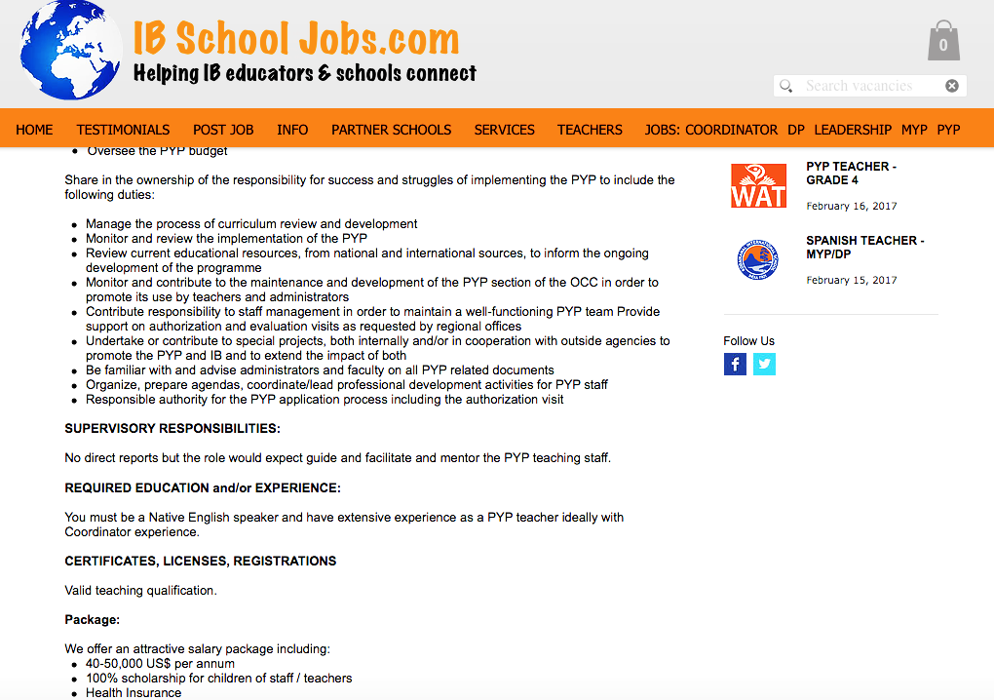
Hiring ONLY Native Speakers

Slide 6
Hiring ONLY Native Speakers

Slide 7
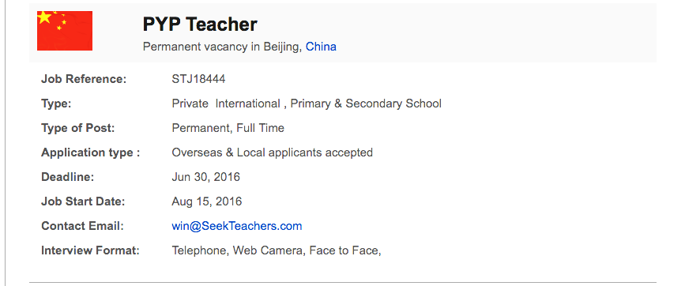
Hiring ONLY Native Speakers

Slide 8
Hiring ONLY Native Speakers

Slide 9
The Impact of ’native speaker’ adverts
”Teaching job announcements that indicate a preference or requirement for a ‘native’ speaker of English trivialize the professional development teachers have received and teaching experience they have already acquired. Such announcements are also discriminatory (…) (and) ultimately harm all teachers (native or not) by devaluing teacher education, professionalism, and experience.”
CATESOL’s position paper opposing discrimination against Non-Native English Speaking Teachers (NNESTs) and teachers with "non-standard" varieties of English (2013)

Slide 10
Some studies on discriminatory hiring practices
Selvi (2010)
Mahmoob and Golden (2013)

Slide 11
Selvi 2010
Focus: employers’ criteria for recruiting EL teachers; importance employers place on a teacher being a NS.
Method: content analysis of 38 advertisements from
TESOL’s On-line Career Center and 211 from
Dave’s ESL Café

Slide 12
Findings
Advert Requirements | Dave’s ESL Cafe | TESOL Career Centre
Native or native-like or near native proficiency | 74.4% | 60.5%
Specific countries of origin or residence (All ‘centre) | 12.5% | 21%
Educational/professional qualifications from American or Anglophone institutions | 1.4% | 13%

Slide 13
Conclusions
A vast majority of the advertisements favoured NESTs and rejected NNESTs.
Discrimination is ‘a multifaceted phenomenon’
Variety of English spoken
Where qualifications were attained
Location of residence or citizenship

Slide 14
Mahmoob and Golden (2013)
Focus: Qualities ELT employers look for
in potential job candidates
Method: content analysis of 77 advertisements
from ESL Jobs World from East Asia
and the Middle East

Slide 15
“Nativeness” was the single most frequent criterion mentioned in the advertisements (79%)
49% of the advertisements listed specific countries from which the applicants must come

Slide 16
Findings
“Nativeness” was the single most frequent criterion mentioned in the advertisements (79%)
49% of the advertisements listed specific countries from which the applicants must come
95% the US
89% the UK
84% Canada
66% Australia
55% New Zealand
37% Ireland
24% South Africa
2 advertisements specified race: “white” or “Caucasian” native speakers

Slide 17
Conclusions
Discriminatory practices against NNESTs continue to exist
Many employers consider “nativeness” an important criterion in making employment decisions
Nativeness was linked to ‘Inner Circle’ Englishes only
Students are taught by individuals who are not qualified to do so.

Slide 18
How does this translate to the IB mission statement and its values?
Intercultural understanding and respect
International mindedness
Inclusion
Celebrating diversity

Slide 19
How do I envision the IB and the IB World Schools for the future?
http://www.ibo.org/jobs-and-careers/open-jobs-at-the-ib/
Create Equal Employment Opportunities a requirement for all member schools.
Create ’Equal Employment Opportunities’ hiring protocol in IB World schools and have it enforced.

Slide 20
“Creating a better and more peaceful world” and Creating a difference
This is how I would like to create a difference in the organisation that I passionately love.
Continue to raise awareness through conferences, school meetings, writing articles, research studies etc.

Slide 21
How are you creating a difference?

Slide 22
I am…
Peter Sagun
Non-native speaker of the English Language
Non-western trained
”Why is still a valid terminology until now to refer to our professional identity of over 80% of English teachers in the world as a NON ?”

Slide 23
Bill Gates says…
”If you want to improve the world, you always have to be a little pissed off…” FB post, 19th September 2017.

Slide 24
Thank you all!!!

