Slide 1
International curriculum without compromising the national identity - whose curriculum is it any way?
منهاج دولي لايتخطى الهوية الوطنية – أي منهاج هذا الذي نتوخاه ونسعى إليه؟
Dr. Samia Al Farra
Chief Education Officer
Taaleem
Alliance for International Education
EDUCATIONAL FUTURES: INNOVATIONS and ASPIRATIONS
20 – 22 October 2012

Slide 2
Introduction
The importance of international education in this era. Quality and quantity.
Definitions: International education and international schools - international mindedness
International schools curriculum in the Gulf Cooperation Council “GCC”-Taaleem schools in Dubai and Abu Dhabi as case studies.
Definition
Subjects taught
The language of instruction
Teachers’ training
leadership and governance
Student body composition
The media and the external environment
Islam and international education - International Education from an Islamic perspective.
"يَأَيهَا النَّاس إِنَّا خَلَقْنَكم مِّن ذَكَر وَأُنثى وَجَعَلْنَكمْ شعُوباً وَقَبَائلَ لِتَعَارَفُوا إِنَّ أَكرَمَكمْ عِندَ اللَّهِ أَتْقَاكُمْ إِنَّ اللَّهَ عَلِيمٌ خَبِيرٌ" سورة الحجرات.
The importance of mother tongue language acquisition at early ages. The role of parents, of the school, of media, society and the responsibility towards SN students.
Definition of: Bilingual, Semi-lingual, Equilingual / Ambilingual and Monolingual.
How can one ensure that our students are firmly rooted in their culture and heritage?
Conclusion

Slide 3
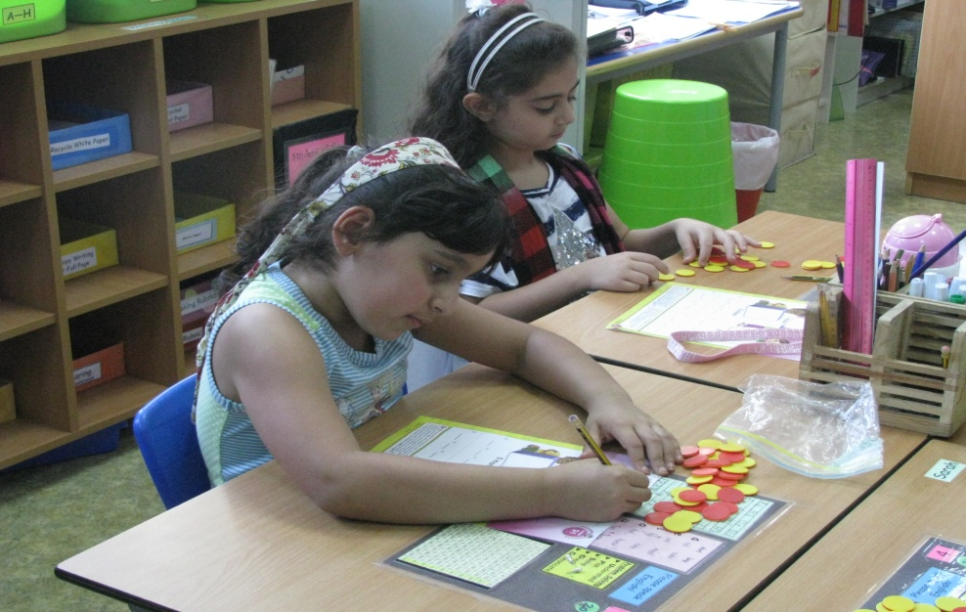
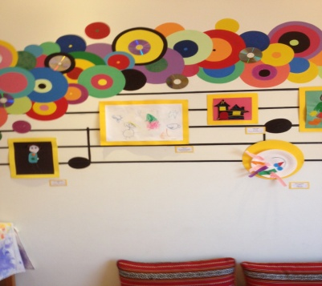
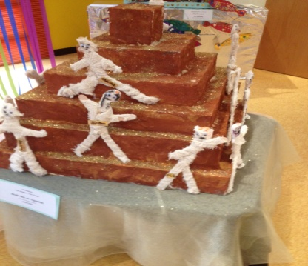
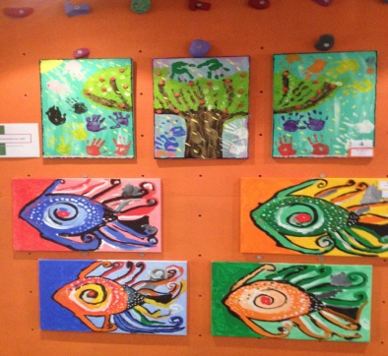
International schools bring joy to students. They are colorful, relevant, active & engaging

Slide 4
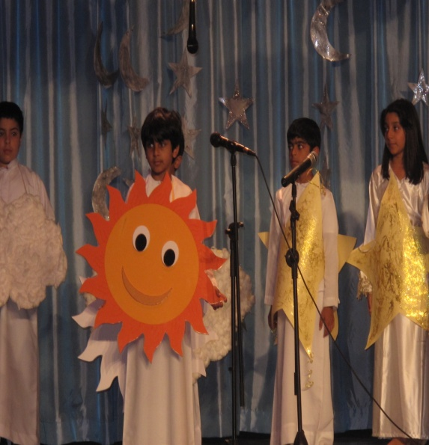
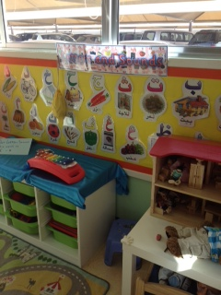
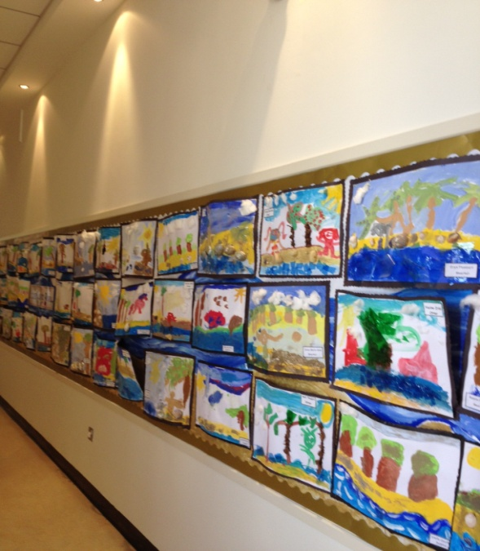
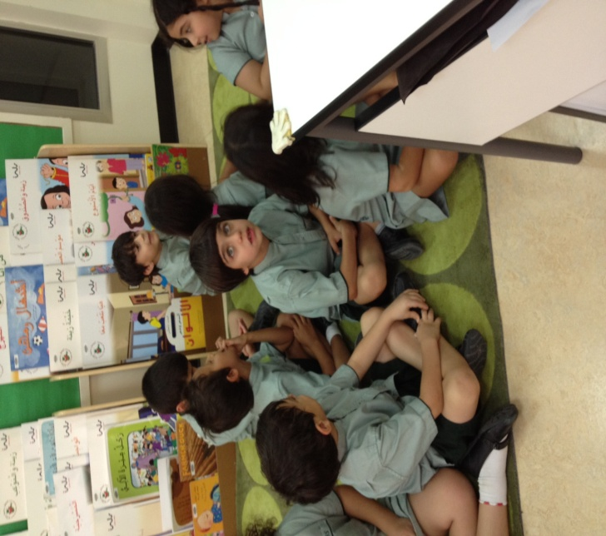
International schools bring joy to students. They are colorful, relevant, active & engaging

Slide 5
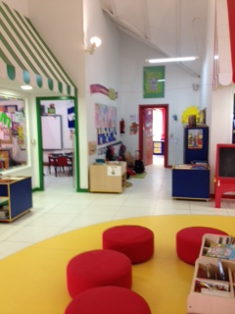
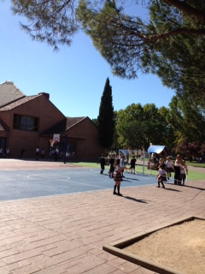
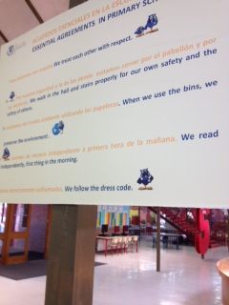
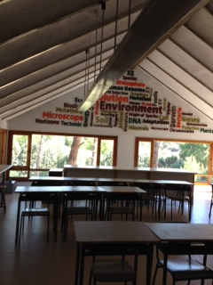
International schools bring joy to students. They are colorful, relevant, active & engaging

Slide 6
Why did the private schools‘ market grow at an unprecedented rate in the Gulf over the last 10 years?
Demographic growth
A flight to quality
A greater willingness among GCC parents to pay for education
“All the above will drive growth in the private-school market over the coming decade, and lead to a transformation in education throughout the region. This evolution will offer sizable growth opportunities for operators and investors—in short, the field is wide open for companies that can navigate several challenges in the region to capitalize on its superior growth opportunities“.
Booz & Company

Slide 7
UAE (Abu Dhabi)
Current Overview
Abu Dhabi currently has a combined enrollment of roughly 300,000 students, across 266 public and 179 private schools in the emirate’s three regions¹. The private-school market size is estimated at roughly $550 million, based on current tuition fee levels and student numbers.
ABU DHABI: K–12 Education system overview
 | Public Schools | Private Schools
Schools | 266 Schools | 179 Schools
Students | ˜128,000 Students | ˜177,000 Students
Teachers | ˜12,000 Teachers | ˜10,000 Teachers
OpEx | ˜US$2 Billion² (˜US$15,700/Student) | ˜US$550 Million³ (˜US$3,100/Student)
Student to Teacher Ratio: 10.6
Student to Teacher Ratio: 17.7
¹ Abu Dhabi Central Capital District, Al Ain (Eastern Region), Al Gharbia (Western Region)
² Direct public spend on public institutions, excluding capital; based on publicly stated teacher staffing levels and advertised teacher salaries.
³ Tuition fees only, excludes transport and other fees.
Source: Abu Dhabi Education Council; Booz & Company analysis

Slide 8
UAE (Dubai)
Current Overview
Dubai is the most advanced private-school market in the GCC. The private-school market is significantly larger than the public-school market: Dubai has 146 private schools, with more than 191,000 students and 12,000 teachers, compared to 78 public schools with about 27,000 students and 2,300 teachers.
Dubai: K–12 Education system overview
 | Public Schools | Private Schools
Schools | 78 Schools | 146 Schools
Students | ˜27,000 Students | ˜191,000 Students
Teachers | ˜2,300 Teachers | ˜12,000 Teachers
OpEx | ˜US$ 400 Million¹ (˜US$15,700/Student) | ˜US$840 Million (˜US$4,400/Student)
Student to Teacher Ratio: 11.5
Student to Teacher Ratio: 16
¹ Direct public spend on public institutions, excluding capital; based on publicly stated teacher staffing levels and advertised teacher salaries.
Source: Dubai Statistical Yearbook; Booz & Company analysis

Slide 9
The importance of international education in this era. Quality and quantity
International education:
International schools:
International mindedness:
Review all Jeff Thompson and Mary Hayden’s work

Slide 10
International schools curriculum in the Gulf Cooperation Council “GCC” - Dubai as a case.
Definition
Subjects taught
Teachers’ profile
The language of instruction
Teachers’ training
Leadership and governance
Student body composition
The external environment and the local language enhancement

Slide 11
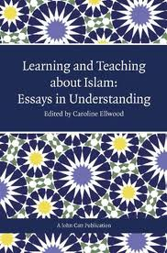
Islam and international education
INTERNATIONAL EDUCATION FROM AN ISLAMIC PERSPECTIVE

Slide 12
The importance of language acquisition at an early ages. The role of parents, of the school, of media, society and the responsibility towards SN students.
What is a bilingual education?
Bilingual: Using or able to use two languages, especially with equal or nearly equal fluency / a person who speaks two languages fluently
Semilingual: A person who has partial or incomplete working knowledge of a language or languages
Equilingual / Ambilingual: A person who is a native speaker of two languages, and or if his mastery of both languages is equalpartial or incomplete working knowledge of a language or languages
Monolingual: a person who knows only one language.
Retrieved from www.thefreedictionary.com

Slide 13
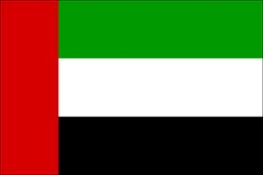
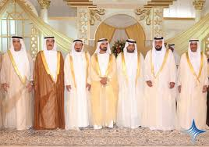
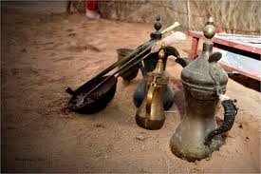
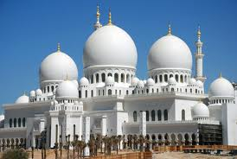
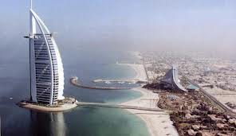
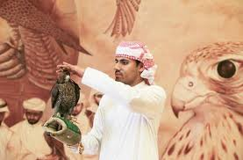
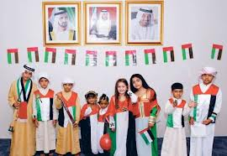
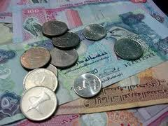
What can we do to ensure that students are firmly rooted in their culture and heritage?

Slide 14
Mission statement/Guiding principles and general goals
IB schools in Dubai as models
ABS Bilingual model in Jordan
Al Bayan bilingual school model- Kuwait
Al Ruy’ya bilingual school model and Al Hayat bilingual school models-Kuwait

Slide 15
Conclusion
International schools are important institutions for improving cross-cultural understanding, combating ignorance and bringing people from different backgrounds together. Their adoption of high standards usually facilitates the development of important skills for the 21st century.
There is an urgent need to develop a semi- balanced (40%-60%) bilingual (Arabic/English) model in the private and public system of schools and universities which will use a new curriculum alongside compulsory and continuous training for teachers. English should never dominate Arabic instruction time for Emirati and Arab students.
Education in the GCC should stress on creating individual students who are: Inquirers, knowledgeable, thinkers, communicators, principled, open-minded, caring, courageous, balanced, reflective, and spiritual.
Any curriculum draft should stem from the Mission and Philosophy of Education in the GCC while bringing an international dimension to it always.
Not all students are capable of joining university and thus we need to have vocational streams in our national strategic plans such as IBCC

Slide 16
References
Alpen Capital Investment Banking. GCC Education Industry. June 20, 2012.
Booz & Co., A Decade of Opportunity. The Coming Expansion of the Private – School Market in GCC., 2011.
Ellwood, C., Learning and Teaching about Islam: Essays in Understanding. Al Farra, S. Internationalism and the Arab Heritage: A practitioner’s experience in International schools. A John Catt Publication., June, 2012
Thompson, J., Hayden, M., International Schools, International Education: improving teaching, management and quality., edited by Mary Hayden & Jeff Thompson. Chapter by Al Farra, S., London: Kogan Page, 2000.
Al Farra,S., Education in the UAE, A vision for the Future., Education in the UAE, current status and future developments. ECSSR, 2011
Definitions retrieved from www.thefreedictionary.com, October 14, 2012

