Slide 1
Global Imaginaries in Teachers’ work July 2010
Julie Dyer
Deakin University
julie.dyer@deakin.edu.au

Slide 2
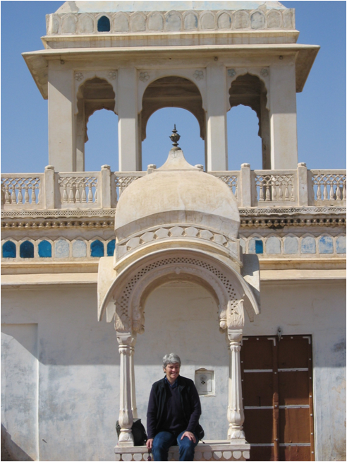
Background
Geography Teacher
Teachers’ work
Professional Learning
Global Education
Studies of Asia
Teacher education
Notes:
how global mobility and travel reshape social imaginaries of teachers and how this might help realise goals of global education. It is located in globalisation, global education and social imaginaries studies in education. It is important because education is an arena where globalisation presents particular challenges requiring new responses to curriculum development, notions of citizenship, identity and teacher attributes required for the 21st century.

Slide 3
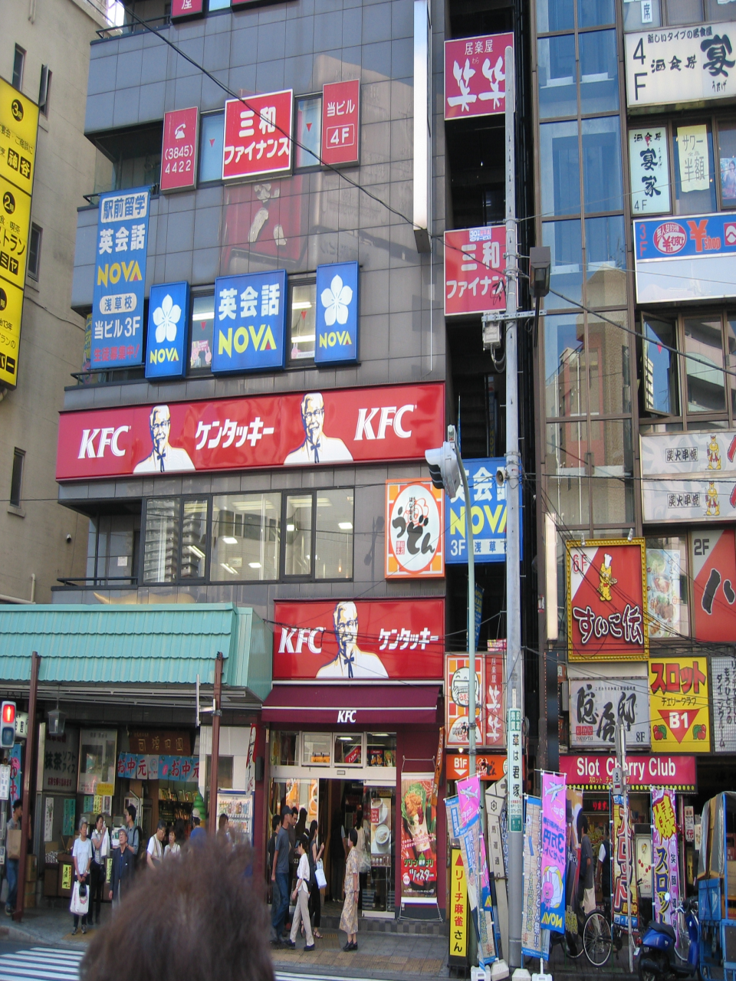
New contexts
Mobility
Interconnectedness
Internationalisation of curriculum
Diversity
Global Imaginings
Globalisation
International Education

Slide 4
Research
Investigate how teachers’ knowledge and identities are influenced through their experience of travel.
Questions
How does the experience of travel shape teachers’ work and identities?
How does this travel then shape understandings of global education?

Slide 5
Theoretical frames
Globalisation as transformative - Appadurai, Giddens and Rizvi
New imaginaries for teachers’ work – social imaginary Taylor, Greene.
Teachers’ work – Holm and Farber

Slide 6
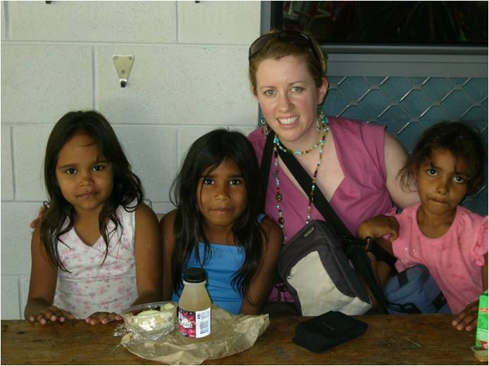
How does travel shape teachers’ work and identities?
New Knowledge - depth of knowledge
Challenging stereotypes
Reconfigured and new curriculum
Classroom Pedagogies
Notes:
Recent knowledge acquired from travel ensures against a static and outdated knowledge. Deep knowledge about a place from experience is shown expressively through Beth’s travel to India as a superior source of knowledge over textbooks and other resources. Her subsequent pedagogies built from authentic knowledge connect to concepts and ideas for students’ learning. Beth’s recognition between flowers and life in India is to enrich and enhance students’ views, so they could see beyond what they already knew. Whilst other experiences such as formal education build knowledge, travel offers an experience afforded by few other learning modes of accelerated knowledge acquisition, through heightened consciousness. It is an important source to build knowledge and shape pedagogy.

Slide 7
Teachers’ Identities
Universal Hospitality
Interconnectivity
Leadership
Notes:
Wendy’s imagination recognises both the frailties of ‘old’ ways embedded in school tradition and opportunities for new practices. Empowered with this realisation, she challenges the ‘habit’ of welcome with the principal.
She voices her concerns with a confidence that comes through ‘new’ knowledge validated by experience. This demonstrates the complexity and unpredictability of diverse ways that new practices come into being (Fairclough, 2001).
This incident explains how Wendy reshapes her own person and alters subjectivities from her travel. She now sees a taken-for-granted practice differently and an embedded aspect of her own person differently.
This demonstrates a heightened sense of consciousness as imagination is stimulated through the influence of travel. Wendy comments that the study tour had impact beyond changed customs and practices in the school, to a deeper connection with her sense of self when she said, ‘So it really helped me to work out how I should be in that context’. Travel gives Wendy agency and empowerment that helps her to work out how to ‘be’, that moves her beyond local and national practices and norms.

Slide 8
How does travel shape understandings of global education?
Global awareness
Depth of knowledge
Interconnectedness
Pedagogies of comparison
Notes:
I have thought about Korean people and Japanese people and thought about the incredible differences between those cultures… So yeah, I guess it is analytical, I think about these things in a more global sense. Travel has an influence on the kind of person that I am as a teacher. I am struggling to define the role between direct teaching and the person in the classroom. We don’t have a choice about global … Kids are on the internet all the time and it is global and we have to keep up with them.
The increasing influence of information and communications technology brings greater interconnectedness and confirms the importance of global education. Beth’s discernment of the differences between Korean and Japanese people represents a depth of knowledge afforded through her travel. She is conscious of her own thinking that adopts a global analytic. Her imaginaries for how education should become are a combination of her own thinking and experiences, plus the realities of students’ life worlds.
Awareness of local bias in curriculum policy, practice and pedagogies is revealed when Beth reconfigures the English curriculum text list. Her increased consciousness raised through travel realises that it is a limited representation of the world’s authors. She then alters and reconfigures this official curriculum. Her actions are a representation of what now ‘should be’ for school curriculum, not what is. Travel stimulated Beth’s consciousness to render the curriculum ‘out of date’ upon return. This action redesigned curriculum towards being more inclusive and diverse. Her global imaginaries remake local curriculum, in turn extending access to new knowledge for students and then place into public view the appropriation of imaginaries seen as new curriculum.

Slide 9
Implications Global/ International Education
Teachers’ work can reconfigure global education as their mindsets and thinking in turn become actions. The trajectories for these changes and influence are neither straightforward nor expected.
For these teachers global education becomes then more than policy and curriculum but altered mindsets and practices informed from travel. These mindsets are now influenced by global imaginaries which in turn reframe and reconfigure their work as teachers.
Notes:
Global mobility and travel has influenced and impacted on teachers from this study. How teachers’ work reconfigures global education is seen as teachers’ mindsets and thinking in turn become actions. The trajectories for these changes and influence are neither straightforward nor expected. Global education emerges not as a framework or dimensions, rather as altered mindsets and ways of thinking that lead to new practices and alterations in their work and lives. These mindsets are global imaginaries which reframe purposes of education to a more global education.

Slide 10
Implications for schools
Teachers as central to the process of internationalisation of the curriculum
Greater acknowledgement of teachers as global educators
Global education is about teachers as well as policy
Professional development draws from lived experiences of teachers.

Slide 11
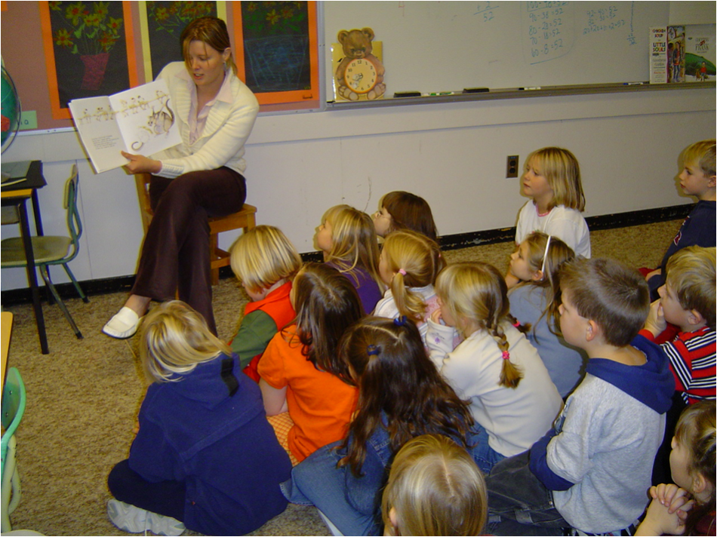
to close...
Certainly travel is more than seeing the sights; it is a change that goes on deep and permanent in the ideas of living. (Beard, 2007)

