Slide 1
GCD
An introduction to the

Slide 2
Think of a graduating student from your community.
Imagine s/he is moving to a new
community. What are two things
about him/her that you are so
proud of, you’d want everyone in
their new community to know?
Notes:
Listen to some examples from around the room? How many of these things are reported on report cards? How many of these things are really academic?

Slide 3
We feel really proud of our
graduates.
Notes:
What are some of the things you know that high school students are doing that you have heard about?

Slide 4
We feel really proud of our
graduates.
When they leave high school,
traditionally, we say
two things about them.

Slide 5
diploma + transcript
Notes:
A traditional diploma says that the student has met the minimum required score in a minimum number of courses.
Transcript produces an overall score that represents, essentially, how smart a student is. Did the min + how smart.

Slide 6
diploma + transcript
{you have met
the minimum grade
in a minimum number
of required courses}
Notes:
A traditional diploma says that the student has met the minimum required score in a minimum number of courses.
Transcript produces an overall score that represents, essentially, how smart a student is. Did the min + how smart.

Slide 7
diploma + transcript
{you have met
the minimum grade
in a minimum number
of required courses}
{how well you
have achieved, as
represented by an
overall number}
Notes:
A traditional diploma says that the student has met the minimum required score in a minimum number of courses.
Transcript produces an overall score that represents, essentially, how smart a student is. Did the min + how smart.

Slide 8
diploma + transcript
Official
NIST Diploma
IB Diploma
Grades
Activity Record
official school ‘permanent’ record

Slide 9
teacher recommendation letters
counsellor reference
diploma + transcript
Official
NIST Diploma
IB Diploma
Grades
Activity Record
official school ‘permanent’ record
school profile
college essays

Slide 10
the whole
story
Notes:
This is not the whole story of all that our students are and have become over their journey in high school.

Slide 11
How do we get our kids to stand out?
Notes:
So the traditional question has been, How do we get our students to stand out from all the others? The problem with this question is that it implies competition on a single scale, and if we only report 2 pieces of information (diploma and overall score), the only way to stand out is to get a better score in a diploma that has a higher minimum standard. We end up spending more of our energy on an small group of elite students.
We believe in the rigor of the IB diploma, but don’t see the value in adding to it.

Slide 12
How do we get our kids to
be seen?
Notes:
So the traditional question has been, How do we get our students to stand out from all the others? The problem with this question is that it implies competition on a single scale, and if we only report 2 pieces of information (diploma and overall score), the only way to stand out is to get a better score in a diploma that has a higher minimum standard. We end up spending more of our energy on an small group of elite students.
We believe in the rigor of the IB diploma, but don’t see the value in adding to it.

Slide 13
diploma + transcript
Official
NIST Diploma
IB Diploma
Grades
Activity Record
official school ‘permanent’ record

Slide 14
more rigor
higher grades
do more stuff
diploma + transcript
Official
NIST Diploma
IB Diploma
Grades
Activity Record
official school ‘permanent’ record

Slide 15
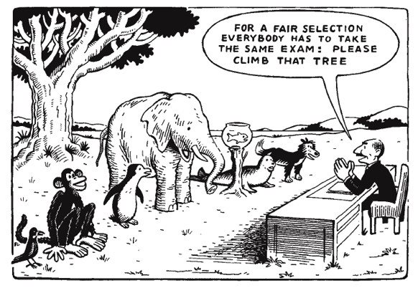
Notes:
When we boil all of the things a student is and does down to a single, summary score, we are trying to compare all students on a single scale, to effectively rank students everywhere. But in doing this, does the one scale we use to measure them by really tell us what it is most important for us to know about this student?

Slide 16
Paradigm Shift
Notes:
So what we really need is a paradigm shift.

Slide 17
Paradigm Shift
How smart?
Quantitative
(Rank/Rate)
Top / Elite
Best
Do More
Notes:
The traditional paradigm sees education as a product—we go to school to get smart. So the measure of success has been tied to the question, How smart is the student? To answer that in an efficient way, we try to quantify it with a score that we can rank or rate. In doing so, we determine who the top students are, the elite students, the Best of the Best. To improve your ranking, traditionally, you have to do more, better.

Slide 18
Paradigm Shift
How smart?
Quantitative
(Rank/Rate)
Top / Elite
Best
Do More
What are they
smart at?
Qualitative
Descriptive Profile
Best Fit
See More of
what they do
Notes:
A traditional diploma says that the student has met the minimum required score in a minimum number of courses.
Transcript produces an overall score that represents, essentially, how smart a student is. Did the min + how smart.

Slide 19
Learning
Life
School
Classroom

Slide 20
Learning
Life
CAS
School
IB
Classroom
Notes:
Diplomas like the IB Diploma ask students to learn outside of the classroom through CAS, for example, but what is actually reported is still an overall score that summarizes academic work done in class.

Slide 21
Learning
Life
GCD
School
Classroom
Notes:
The GCD tries to validate and count all of a student’s learning. In class, in the larger entity of school, and in the world beyond.

Slide 22
How?
Notes:
How do students work towards the GCD?

Slide 23
CORE
ELEMENTS
Fundamentals of Global Citizenship

Slide 24
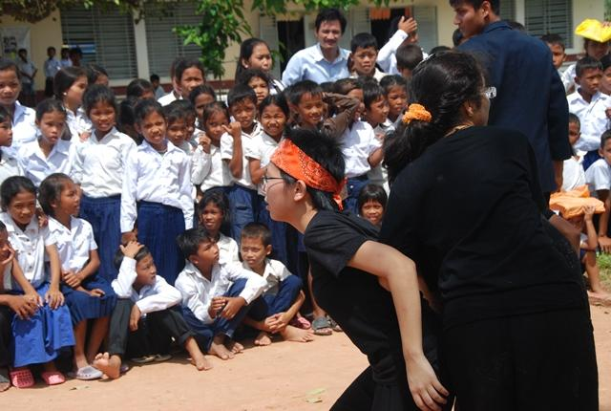
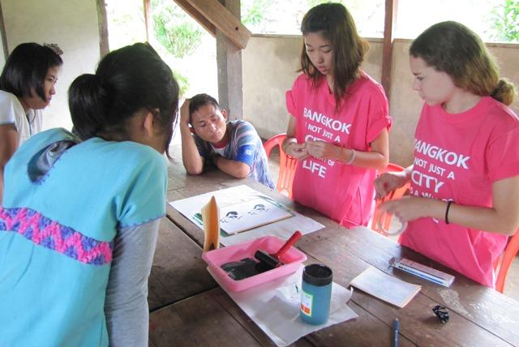
Communications
Global
Perspectives
Community
Engagement
Notes:
The core elements of the GCD represent the foundations of proactive, global citizenship. These are students who are willing and able to COMMUNICATE their ideas and ACT with an AWARENESS of context and consequence.

Slide 25
EXTENDED
ELEMENTS
Individual talents and passions

Slide 26
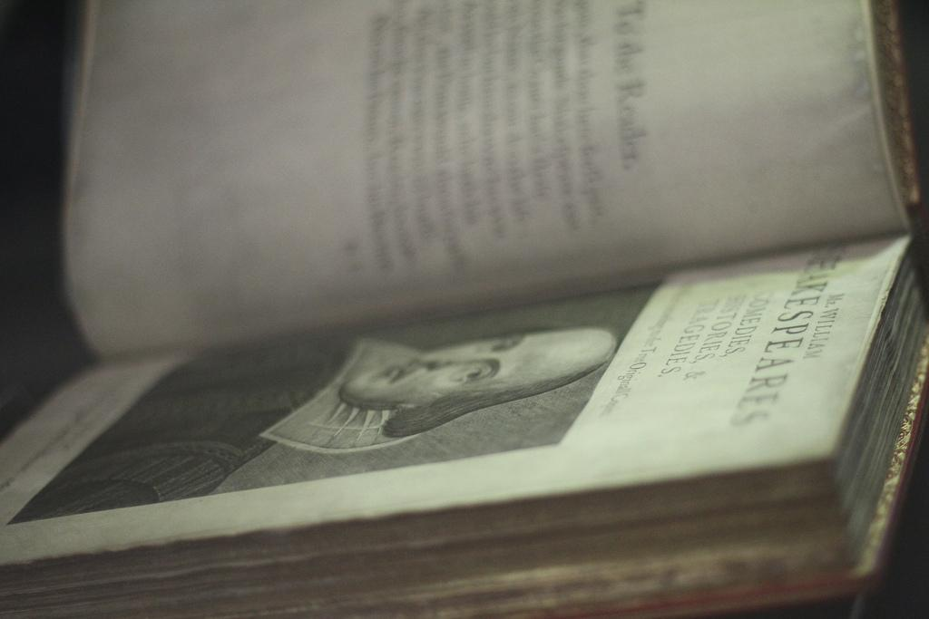
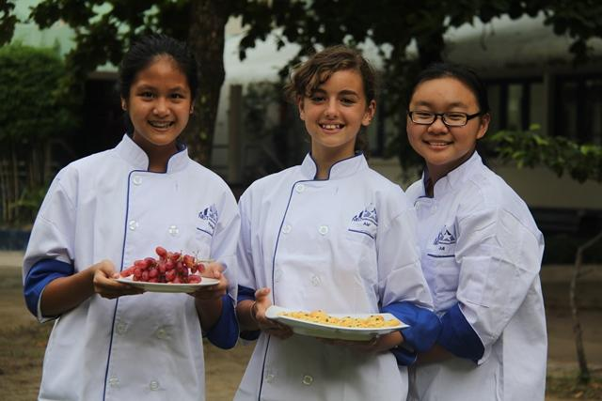
Academics
Adventure
Apprenticeship
Notes:
The extended elements recognize the individual talents that students have, the lenses through which their global citizenship may manifest.

Slide 27
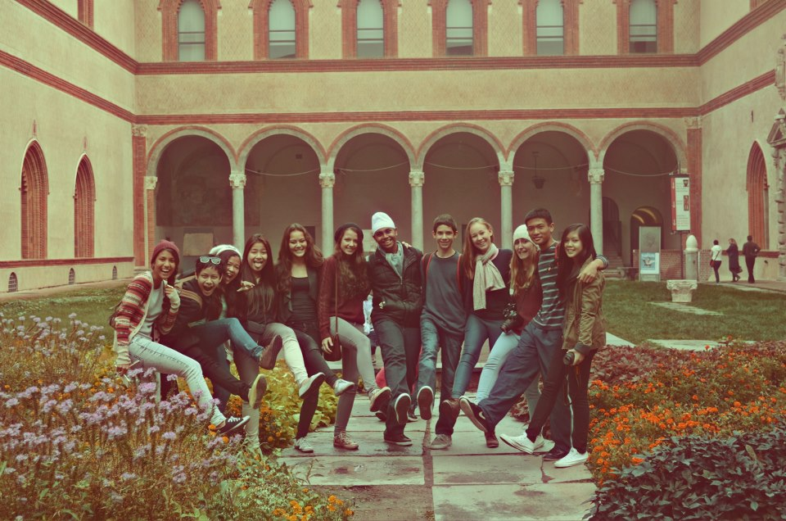
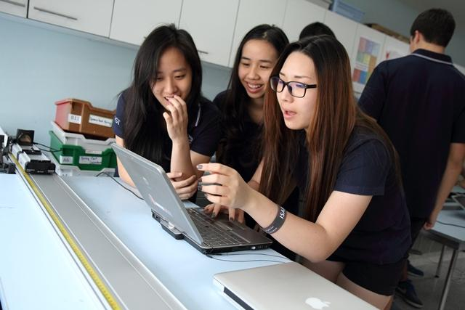
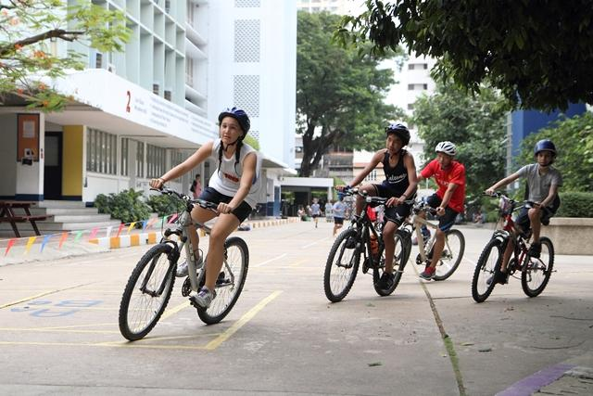
Arts For Life
Digital Citizenship
Fit For Life

Slide 28
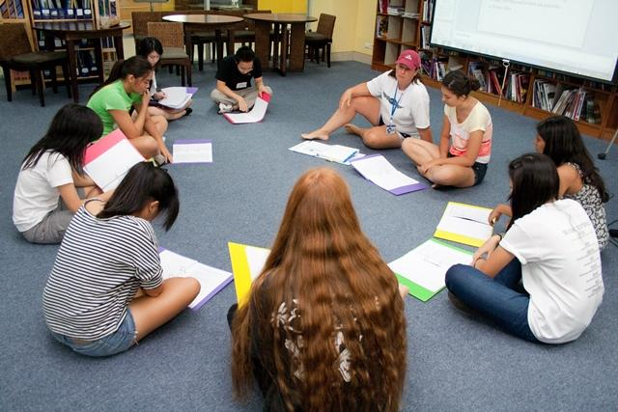
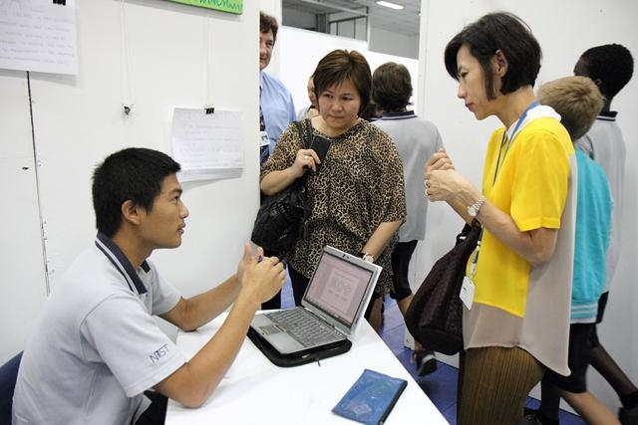
Management
Personal
Goal

Slide 29
ADVANCED
ELEMENTS
Highly developed skills

Slide 30
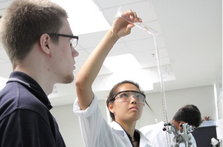
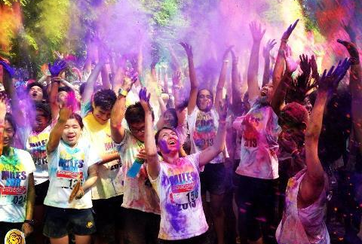
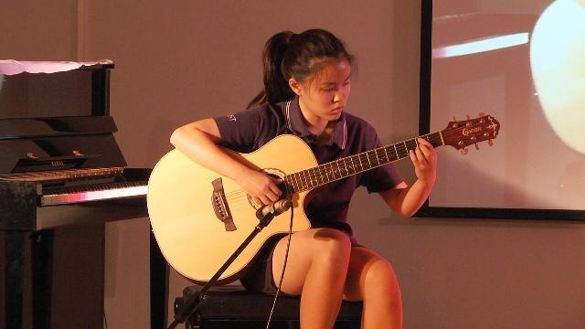
Advanced
Academics
Advanced
Leadership
Advanced
Personal
Accomplishment
Notes:
Advanced elements recognize exceptional achievement, where students have fulfilled and exceeded their potential.

Slide 31
3 Levels of Recognition
Notes:
The diploma is offered at three levels of recognition.

Slide 32
Global Citizen Certificate
Notes:
The Global Citizen Certificate is awarded to those who are described by the core elements of the GCD and one extended element. Because the extended element does not have to be academics, the student does not have to graduate in order to be awarded the certificate. This is particularly relevant to students who do not finish their high school careers in GCD member schools.

Slide 33
Global Citizen Diploma
Notes:
The Global Citizen Diploma is awarded to students who are described by the core elements of the GCD plus 6 of the 8 extended elements, including the Academics requirement of graduation from High School.

Slide 34
Global Citizen Diploma
with Distinction
Notes:
The Global Citizen Diploma with Distinction is awarded those few students who are described by all of the elements of the GCD.

Slide 35
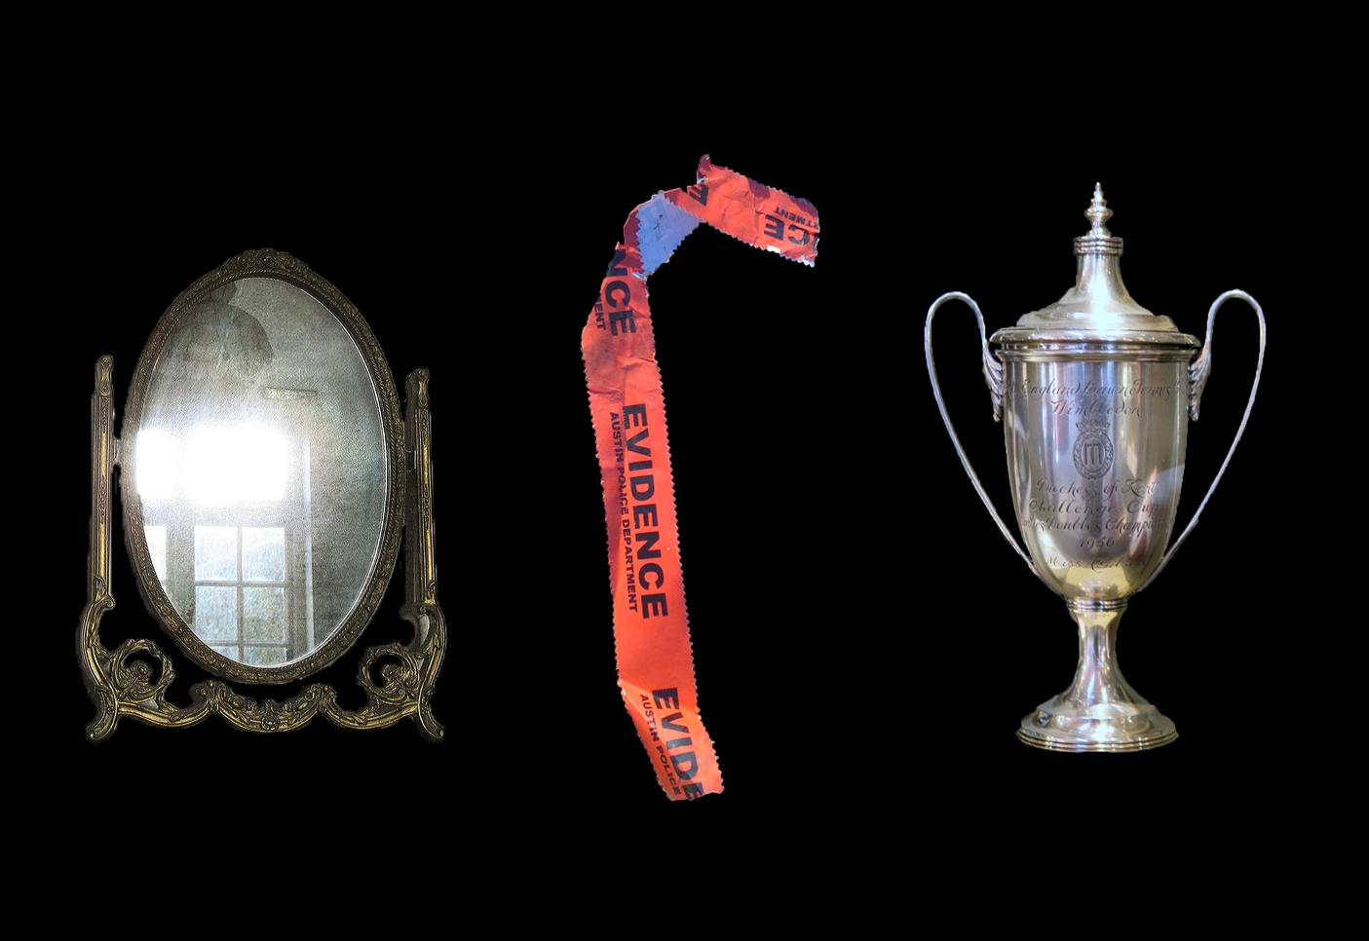
Notes:
Students write qualitative reflections about their learning experiences. They must provide evidence of the learning activity, and of their participation in it. Reflections follow the Universal Reflection Guidelines so that reflections written for CAS can also be used for the GCD, with perhaps, an additional sentence or two to tailor the reflection to the GCD context. Students can use this format to reflect on class work too. Students record their reflections on their blogs, and categorize each post based on the element of the GCD they feel describes the learning. One learning experience can be described by 2 elements of the GCD.
When students have completed their reflections, they select their 5 most profound learning experiences/reflections and create a category for them called GCD Showcase. The link to this showcase is shared with university recruiters and admissions officers in the Letter of Conditional Award of the GCD.
(The image here is hyperlinked to the Reflection Guidelines page of the GCD Website)

Slide 36
Reflection Writing
Deadline
Reading Period
Moderation Meeting
Revision / writing
Deadline
Notes:
There are 4 submission deadlines and reading periods each semester. Semester 1 is reserved for G12 reflections as they are completing their university applications. Second semester submissions are open to G9 to G12.
During the reading period, GCD Committee readers review the submitted reflections and approve them or provide feedback on what still needs to be done/described to meet the element criteria. Feedback can be given as a comment on the blog, or by email directly to the student. If revisions are required, students revise and submit the post again for the next submission deadline. If a reader is uncertain of whether or not a reflection meets the criteria, s/he makes some notes and the post is discussed with the other readers at the moderation meeting. The committee makes a decision and the original reader informs the student by email or blog.

Slide 37
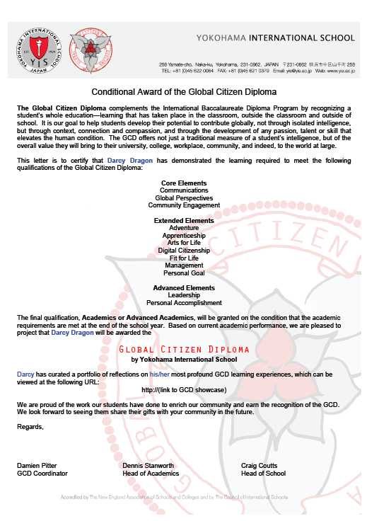
Notes:
For complete information, see the GCD website.

Slide 38
MORE
WORK
Notes:
The question all teachers need the answer to: Is this going to be more work for me?

Slide 39
No.
Notes:
The GCD does not create more work for teachers, unless they wish to join the GCD Reading Committee, and then it creates only a little more work. But, be aware that your students may be pursuing the GCD and may be thinking about activities you supervise in that light. It would be helpful if you think about recording activities you supervise and sharing anything students might use as evidence of their participation eg. sports videos used for training, rehearsal footage, concert footage etc. Please be familiar with the GCD so you can remind students of ways their learning experiences might contribute to their GCD.

Slide 40
DIFFERENT
WORK
Notes:
The question all teachers need the answer to: Is this going to be more work for me?

Slide 41
GCD Website
globalcitizendiploma.org
Notes:
For complete information, see the GCD website.

Slide 42
Photo Credits
Mirror Photo Credit: The hills are alive* via Compfight cc
Evidence Tape Photo Credit: Andy on Flickr via Compfight cc
Trophy Photo Credit: cliff1066™ via Compfight cc
Notes:
Photo credits for images used but not taken by in-school photographers

