Slide 1
Dr Barry J Hallinan
Emotional knowledge and cultural awareness in university guidance and the application process from the perspective of the globally minded Sixth Former/High School Senior: Daedalus or Icarus?

Slide 2
Who was Daedalus?
Skilful and ingenuous craftsman, artist, inventor, innovator, carpenter, creator.
Name very close to “to work artfully”
Father of Icarus
Daedalus is first mentioned by Homer as the creator of a wide dancing-ground for Ariadne
He also created the Labyrinth on Crete in which the Minotaur (part man, part bull) was kept.

Slide 3
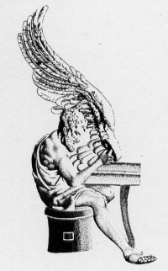
Daedalus at work

Slide 4
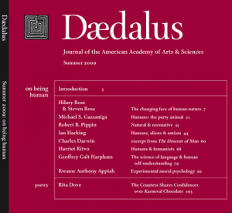

Slide 5
Who was Icarus?
Son of Daedalus
Rough around the edges- inexperienced
High flying ambitious young man
Emotional and headstrong
In the psychiatric mind, features of disease were perceived in the shape of the pendulous emotional ecstatic-high and depressive-low of bipolar disorder.

Slide 7
Daedalus and Icarus
The most familiar literary telling explaining Daedalus' wings is a late one, that of Ovid: in his Metamorphoses (VIII:183-235)
Daedalus was shut up in a tower to prevent his knowledge of his Labyrinth from spreading to the public.

Slide 8
Daedalus and Icarus
Icarus' father warns him first of complacency and then of hubris
Hubris often indicates a loss of contact with reality and an overestimation of one's own competence, accomplishments or capabilities.
Icarus is guilty of failed ambition
He is unable to heed the word of those who have gone before him

Slide 9
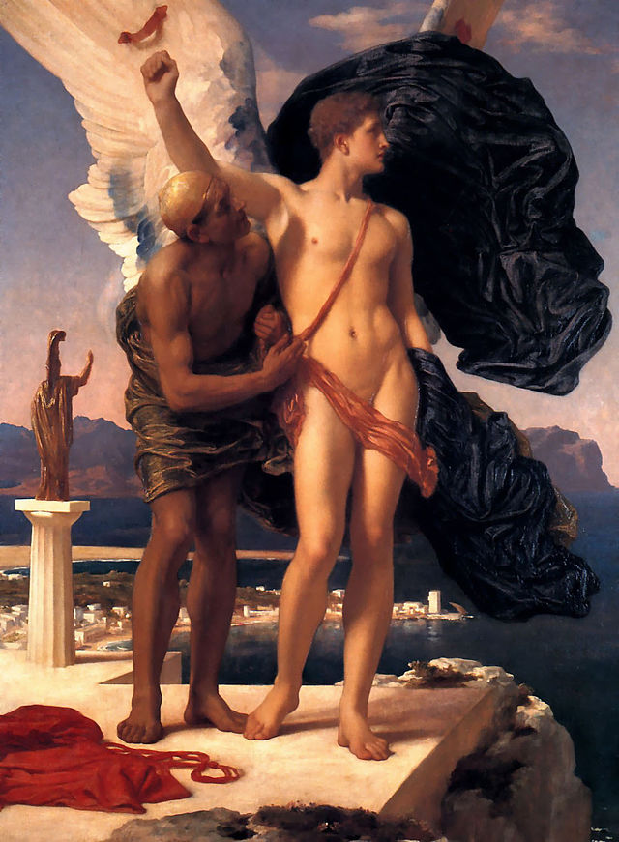

Slide 10
Emotional Intelligence / Knowledge
Emotional intelligence (EI) is the ability to monitor one's own and other people's emotions, to discriminate between different emotions and label them appropriately, and to use emotional information to guide thinking and behavior. There are three models of EI.

Slide 11
3 working models
The ability model, developed by Peter Salovey and John Mayer, focuses on the individual's ability to process emotional information and use it to navigate the social environment.
The trait model as developed by Konstantin Vasily Petrides, "encompasses behavioral dispositions and self perceived abilities and is measured through self report".
The final model, the mixed model is a combination of both ability and trait EI. It defines EI as an array of skills and characteristics that drive leadership performance, as proposed by Daniel Goleman.

Slide 12
Emotional Intelligence / Knowledge
Perceiving emotions
Using emotions
Understanding emotions
Managing emotions

Slide 13
Quick fit defintion
The emotionally intelligent person can harness emotions, even negative ones, and manage them to achieve intended goals.

Slide 14
IB Learner Profile
Inquirers They develop their natural curiosity. They acquire the skills necessary to conduct inquiry and research and show independence in learning. They actively enjoy learning and this love of learning will be sustained throughout their lives.
Knowledgeable They explore concepts, ideas and issues that have local and global significance. In so doing, they acquire in-depth knowledge and develop understanding across a broad and balanced range of disciplines.
Thinkers They exercise initiative in applying thinking skills critically and creatively to recognize and approach complex problems, and make reasoned, ethical decisions.
Communicators They understand and express ideas and information confidently and creatively in more than one language and in a variety of modes of communication. They work effectively and willingly in collaboration with others.
Principled They act with integrity and honesty, with a strong sense of fairness, justice and respect for the dignity of the individual, groups and communities. They take responsibility for their own actions and the consequences that accompany them.
Open-minded They understand and appreciate their own cultures and personal histories, and are open to the perspectives, values and traditions of other individuals and communities. They are accustomed to seeking and evaluating a range of points of view, and are willing to grow from the experience.
Caring They show empathy, compassion and respect towards the needs and feelings of others. They have a personal commitment to service, and act to make a positive difference to the lives of others and to the environment.
Risk-takers They approach unfamiliar situations and uncertainty with courage and forethought, and have the independence of spirit to explore new roles, ideas and strategies. They are brave and articulate in defending their beliefs.
Balanced They understand the importance of intellectual, physical and emotional balance to achieve personal well-being for themselves and others.
Reflective They give thoughtful consideration to their own learning and experience. They are able to assess and understand their strengths and limitations in order to support their learning and personal development.

Slide 15
Two College Application Portals
UK- UCAS (www.ucas.com)
and
US and UK - Common App (www.commonapp.com)

Slide 16
What Colleges Say
First the USA.... take a random Ivy league.....Yale
1. Applying to college can be an overwhelming and intimidating process for any student.
2. Former Yale President Kingman Brewster wrote that “selecting future Yale students was a combination of looking for those who would make the most of the extraordinary resources assembled here, those with a zest to stretch the limits of their talents, and those with an outstanding public motivation – in other words, applicants with a concern for something larger than themselves”.
3. The great majority of students who are admitted stand out from the rest because a lot of little things, when added up, tip the scale in their favor.

Slide 17
What colleges Say
Now let’s look at the UK......Oxford University
Outstanding Grades
Wider Reading
Strong Interview
Genuine Enthusiasm for the Subject
Top in Pre-entry Tests

Slide 18
What is expected of any applicant
SAT Back to School Kit – Bring your students closer to their dream of higher education
Guide Encourage Inspire
They are expected to be emotionally mature, able to comprehend the competitive nature of the process, work with complex variables, make impactful decisions....mostly at 17/18 yrs
Get themselves known to colleges as a suitable option (match subject to object)

Slide 19
What is expected of any applicant
Engage with this process 24/7
UK vs. USA – Liberal Arts / Core Classes etc
Be ready (emotionally intelligent) to work with denials or having to make difficult choices
Be genuine and authentic in all writings (see essay prompts)

Slide 20
The actual application itself
2014-15 Common Application Essay Prompts 650 words
Some students have a background or story that is so central to their identity that they believe their application would be incomplete without it. If this sounds like you, then please share your story.
Recount an incident or time when you experienced failure. How did it affect you, and what lessons did you learn?
Reflect on a time when you challenged a belief or idea. What prompted you to act? Would you make the same decision again?

Slide 21
The actual application itself
Describe a place or environment where you are perfectly content. What do you do or experience there, and why is it meaningful to you?
Discuss an accomplishment or event, formal or informal, that marked your transition from childhood to adulthood within your culture, community, or family.

Slide 22
What is expected of the school
Have in-depth knowledge (emotional and otherwise!) of the fast changing, highly competitive global application pool
Submit a competitive Profile
Know the strengths and growth points of all applicants
Create the best fit scenario
Keep them on the straight and narrow
Bring parents on board
Not miss a single deadline

Slide 23
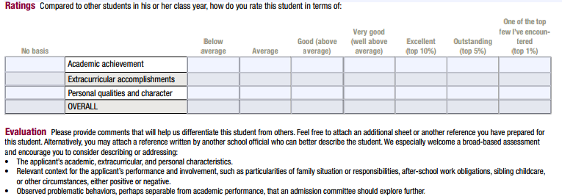
Do you recognise this?

Slide 24
Linking Daedalus and Icarus
Know thyself
Plan ahead
Use previous knowledge and experience to guide and inform
Listen carefully – heed others- learn from their mistakes but do not lose individuality
Have Plan B ready (eggs and baskets)

Slide 25
One parting thought:
You can never cross the ocean unless you have the courage to lose sight of the shore.

Slide 26
Thank you all for listening

