Slide 1
Safeguarding International Schools from Radicalisation. Schools and their wider communities. AIE Amsterdam 2017
bastablesolutions.com

Slide 2
Student Radicalisation
Background – extremism
Safeguarding – schools
Prevent Policy in the UK
Vulnerability of students
School response
Discussion
Copenhagen — A Danish court convicted a teenage girl of attempted terrorism for planning bomb attacks against two schools. May 2017 (Google image)
Notes:
This presentation considers the international problem of Student radicalisation using the Prevent Policy in the UK as one example of a response to it.
The images used in this presentation are open source or my own images to be used for educational purposes only. The pictures of book covers are for illustration only.

Slide 3
Security in an International School
BastableSolutions.com
Notes:
I needed to know that my school was not a soft target for attack and was safe from intruders and kidnap. It was only in the last few years as a school Director that I realised the problem might come from within!

Slide 4
What has changed?
www.google.com
Notes:
Returning to Europe I found a number of things have drastically changed in recent years– 1. Ordinary people – travellers, pedestrians, holiday makers -and schools have become legitimate targets in the eyes of extremists. 2. The emergence of the ‘lone wolf’ a shooter, a sadly common occurrence in schools in America, is now happening in Europe. 3. Following bomb attacks on transport and transport hubs we now vehicle ramming attacks in places where people gather. 4. Most recently with the growth of the web we see the radicalisation of vulnerable people, especially teenagers, through grooming on the internet.
I have come back to a different and more dangerous world. The British Government along with the military have produced an app for everyone to carry on their mobile phone. Citizen Aid. Get it if it is not on yours – it could save a life.
European culture, Western culture, is under attack. Here too the attack is from within!
Most of the perpetrators of these awful crimes have been living within our communities.

Slide 5
Radicalisation of students
africawitness.wordpress.com
Notes:
Terrorist organisations (in this example Al-Shabab – Somalia ) have no qualms about radicalising children to become fighters. Our international students are constantly exposed to images like this on their smartphones and computers.
Young people pass links to each other. They consider their peer connected networks to be credible information. How are international schools dealing with this?

Slide 6
The Manchester Bomber
Values and Ethos Statement
At Burnage we believe that we must prepare our boys to be the best that they can be in a number of ways. Obviously we want them to achieve the best that they can academically. We must make sure that they learn well in every lesson, every day and achieve their best possible exam results. Whatever your son’s ability, we must help him be his very best.
Notes:
Here is another image of a teenager posing with a gun. Abedi went to a Manchester school, Burnage Academy for Boys, from 2009 to 2011. A school which may not be unlike your own.
It is obvious that an ethos statement is not enough! The question I ask in this presentation is what are schools going to do about radicalisation?
Read more: http://www.dailymail.co.uk/news/article-4536624/Salman-Abedi-known-security-services-point.html#ixzz4iRv5piC5
Follow us: @MailOnline on Twitter | DailyMail on Facebook

Slide 7
Notes:
Not long ago a hate attack on a Jewish school in Toulouse, left four people dead including the principal’s eight year old daughter. Only a few months ago in Grasse, France there was an attack by a student, which was not terrorist inspired, however, the model of attacking school is now out there for disturbed minds to copy.

Slide 8
Radicalisation
www.bbc.co.uk
Notes:
Bullied teenager Ali Sonboly from Munich seems to have been obsessed with mass shootings. He advertised on FaceBook free meals at the local MacDonalds and shot those who turned up. None of his teachers spotted that he had a problem. Photograph: bild
British teacher Jamshed Javeed a biology teacher was radicalised and preparing to travel to Syria to fight with ISIS.’ Fortunately colleagues did notice changes in him. He was jailed for six years. Are the background checks you do when you employ British teachers or when you accept new students considering radicalisation?

Slide 9
'Opportunities missed' to stop brothers' Syria deaths
Notes:
Opportunities were missed to spot the radicalisation of these two teenage British Muslim brothers who died fighting in Syria in 2014. A report found Abdullah, 18, and Jaffar, 17, were both killed having followed their older brother, Amer, to Syria to fight for an Al-Qaeda-affiliated jihadist group.
Both boys had suffered bullying and racism, and had reported physical abuse by their father. The British press questioned why they were not spotted in school and their radicalisation prevented. How log will it be before an international school is prosecuted for failing to prevent a child being radicalised?

Slide 10
Student radicalisation under Daesh. The threat from within our schools and communities.
FaceBook Talha Asmal www.birminghammail.co.uk
Notes:
Daesh made particular publicity out of children fighters. 17-year-old Talha Asmal, from Dewsbury, West Yorkshire, was believed to have become Britain’s youngest suicide bomber after Islamic State said he was the driver of a vehicle packed with explosives in an attack on an oil refinery in northern Iraq. As the so called Islamic State collapses young Daesh fighters, battle experienced are now flooding back into Europe. Some may enrol in your school.

Slide 11
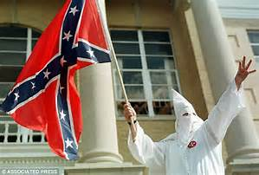
Extremists and hate crimes
https://cloudfront.net Ku-Klux-Klan-.jpg
Anders Breivik
Notes:
Extremists are found in every country.
Labelling extremism as an ‘Islamic’ problem is dangerously misleading – in 2011 an insane right wing idealist Anders Breivik murdered 69 participants of a Workers Youth League summer camp in Norway. It is not wise to think your school is safe because it is long way from the Middle East. In Cambridgeshire we are quite concerned with far right ‘neo-nazi’ groups like ‘National Action’.

Slide 12
The lone shooter. Dunblane Massacre 1996
Thomas Hamilton set off in his van with four handguns for Dunblane Primary School.
There he killed 16 children and the teacher.
Notes:
So our worries go beyond Islamic fundamentalism. The lone shooter is an example of extremist behaviour which has been a threat to schools for some years. Witness the atrocity only days ago in Las Vegas.
The motivation is usually different and the lone shooter is often a member of the local community. The lone shooter should be a major concern for schools in countries where guns are readily available. Has your school done a security audit to see how vulnerable your campus is?

Slide 13
Why do young people become involved in terrorism?
There are many reasons why this may happen. Here are just some:
•a lack of identity or belonging
•insecurity
•defending their culture, way of life or beliefs
•they may be pressured, or bullied into it
•they may have been radicalised by violent extremist groups
•they may want retaliation
Notes:
Why do young people become radicalised and involved in terrorism?
I think you will realise the same reasons listed here would apply to international students. Reading Maajid Nawaz book ‘Radical’ explains a lot. I recommend it to you. He explains that racism, violence and injustice plays a part. Retaliation to imagined injustice looms large in his analysis. Your school can do a lot to protect your students by attending to their social needs and vulnerabilities. It should be no surprise that ‘Daesh is appealing to those young people who for whatever reason are lonely and starving for a close friendship.’

Slide 14
Safeguarding our schools
Radicalisation
Notes:
This brings us into the familiar area of student safeguarding. Safeguarding children and staff is something all schools have become good at.

Slide 15
CONTEST
CONTEST; Government’s counter-terrorism strategy
Prevent-preventing people becoming involved in terrorism
Protect-measures to reduce risk
Pursue-policing
Prepare- emergency planning
Notes:
The government’s counter terrorism strategy is called Contest. This document is openly available on line and you could make use of it. There are four bullet points to it all beginning with P.
The prevent part pertains to our work in schools.
Radicalisation: A process by which an individual or group comes to adopt increasingly extreme political, social or religious ideals and aspirations that reject or undermine the status quo or reject/or undermine contemporary ideas and expressions of freedom of choice.

Slide 16
The Prevent duty
Safeguarding is a vital responsibility shared by all members of our community. This now includes a statutory duty under Section 26 of the Counter Terrorism and Security Act 2015.
This is known in schools as the ‘Prevent’ strategy and all staff and Governors must receive training.
WRAP – workshop to raise awareness of Prevent
Notes:
Since 2015 the Prevent duty is a statutory duty in UK schools. Schools have been updating all other policies to come in line with it. Teachers and governors must attend a Prevent workshop.

Slide 17
Key documents
Working Together to Safeguard Children March 2015
Keeping Children Safe in Education July 2015
Notes:
Schools have a Duty of Care to protect children form radicalisation. Schools and colleges must comply. Governing bodies in the UK must read and comply with these documents which are available online and provide statutory guidance.

Slide 18
Forget radicalisation in mosques - 'Sheikh Google' is the real threat to young Muslims.
The internet: ‘..the electric current connecting the global Ummah’ bin Laden
(Ummah: “The whole community of Muslims bound together by ties of religion.)
Notes:
Impressionable young girls like Aqsa Mahmood, 20, left her family in Glasgow to join extremists in Syria The internet is providing a real threat to young people. Grooming which we have been made aware of through sexual exploitation is also being used for radicalisation. Al Qaeida and Daesh make particular use of it. Increasingly lonely young adults using the internet become self-radicalised.

Slide 19
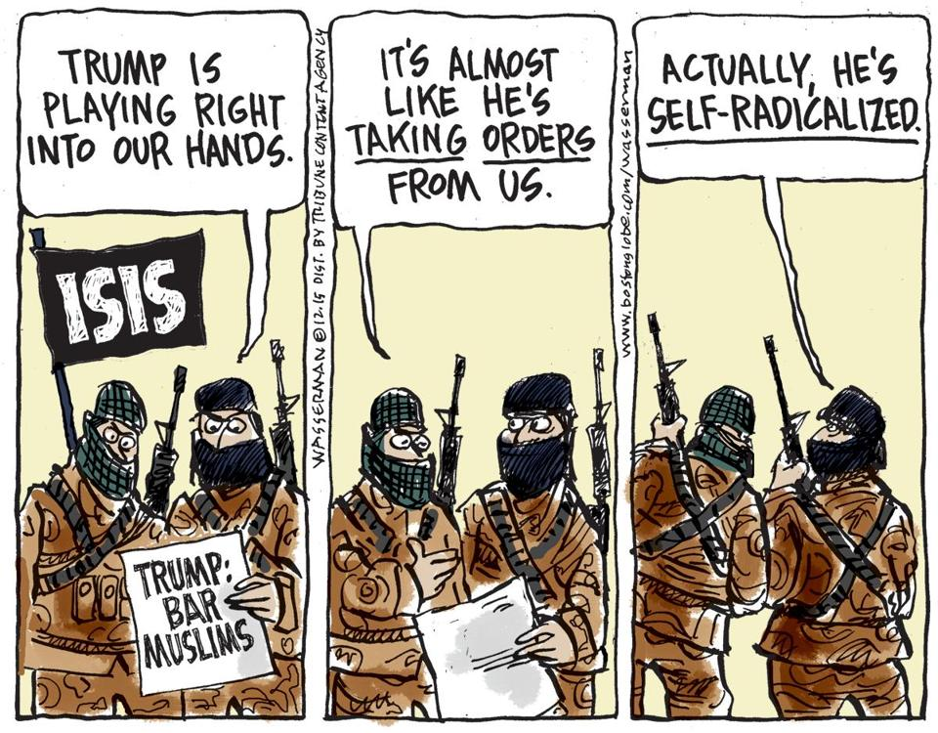
www.bostonglobe.com

Slide 20
The Internet as a Terrorist Tool
‘Schools told to track websites visited by pupils to stop them becoming radicalised in the classroom
Government orders schools to install tougher online filters on computers
Pupils will also be given lessons in staying safe online from the age of five.‘
By Tamara Cohen, Political Correspondent for the Daily Mail
•Published: 00:10, 22 December 2015
Notes:
White paper published in 2009 by the US Department of Homeland Security. ‘The internet as a terrorist tool for recruitment and radicalisation of youth. In this paper the possibility of self-radicalisation is strongly made, particularly in alienated immigrant populations.
Terrorist groups manipulate the grievances of alienated youth.
Young people pass links to each other. They consider their peer connected networks to be credible information. So the internet acts as an accelerant in the formation of extreme views.

Slide 21
Internet Risk
90% of radicalisation happens through this means.
The greatest safeguarding threat to children/young people is the internet and we have a duty to support them using it wisely.
There is evidence that students can access sites from their schools.
Notes:
Schools in the UK have been instructed to make their internet provision safe. How safe is yours?

Slide 22
School Practices
E-safety practice
Thought for the week –’British values’
PSHCE curriculum
Computing curriculum
Pastoral support
Safeguarding team
Notes:
Schools are approaching this challenge through various practices: see slide

Slide 23
Response from schools
Notes:
Publishers have responded to demand by producing Teacher’s Handbooks for use in lessons.
Published by ‘Brilliant Publications’ a teacher’s handbook. Full of resources.

Slide 24
Challenges to the Prevent Strategy
Notes:
According to the UK’s most prominent Muslim lawyer,
Nazir Afzal, Islamist groups in Britain are undermining the fight against terrorism by peddling “myths” about the government’s key anti-radicalisation policy. He warned that an “industry” of Muslim groups was spreading misinformation about the Prevent strategy.
(Mr Afzal, prosecuted the Rochdale sex-grooming gang) He also condemned “self-appointed” community leaders whose sole agenda was to present Muslims “as victims and not as those who are potentially becoming radicals”.
However, researchers say schools and colleges now see Prevent as an extension of their role to keep pupils safe.
Questioning radical views is something that we must do even if it can involve risk.

Slide 25
Hope in the most peaceful of times
Notes:
I highly recommend ‘Radical’ by Maajid Nawaz to you. How he deradicalized and now works to prevent others following his mistaken path. He gives many examples of how this can be done.
Keeping things in perspective. The world is actually more peaceful than in it has been in previous times despite the media.
In ‘Sapiens’ by Yuval Harari, he reminds us that despite all the talk of terrorism, the average person is more likely to kill himself than to be killed by a terrorist, a soldier or a drug dealer.’ Page 411
Harari claims that crime actually kills more people globally than wars do, more people kill themselves than both these put together, and more people are killed on the roads than any of these.
Sapiens, A brief History of Mankind, Yuval Noah Harari, Vintage Books, London 2011

Slide 26
Notes:
Finally, you have great students and great schools. You need to attend to the threats of terrorism and radicalisation however, you are best at creating culturally aware, ethically responsible, community minded, creative young people. I suggest you keep these concepts in balance.
As well as thinking how to protect your school from a terrorist consider how to prevent your school from producing one! Dunblane School is remembered for the atrocity not the school’s recovery or the survival of student Andy Murray.
Do what you do best continue to produce open-minded, tolerant young people. Also make sure they are in a safe environment.

Slide 27
Are international schools doing enough to prevent the radicalisation of students?
The rest of the session is now thrown open to you.
Notes:
If International Schools are to provide similar safeguarding to that in the UK they will have to look at introducing something like a Prevent Strategy. No school can afford to be the subject of an attack or be the school which produces the perpetrator of one.

